Slide 1



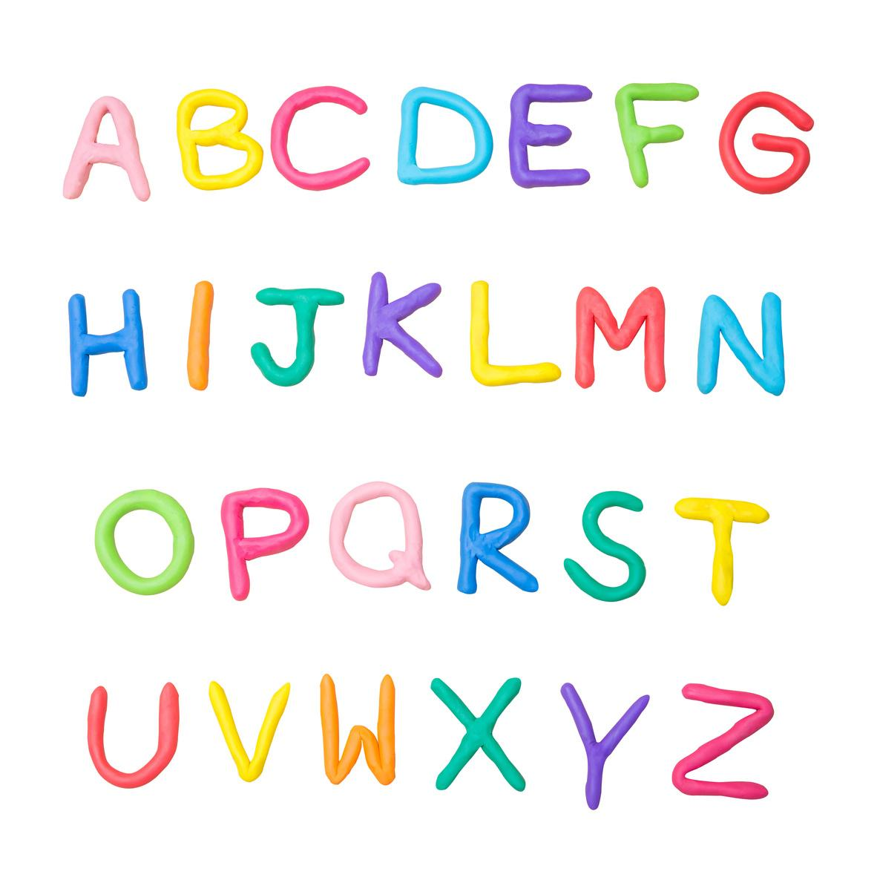
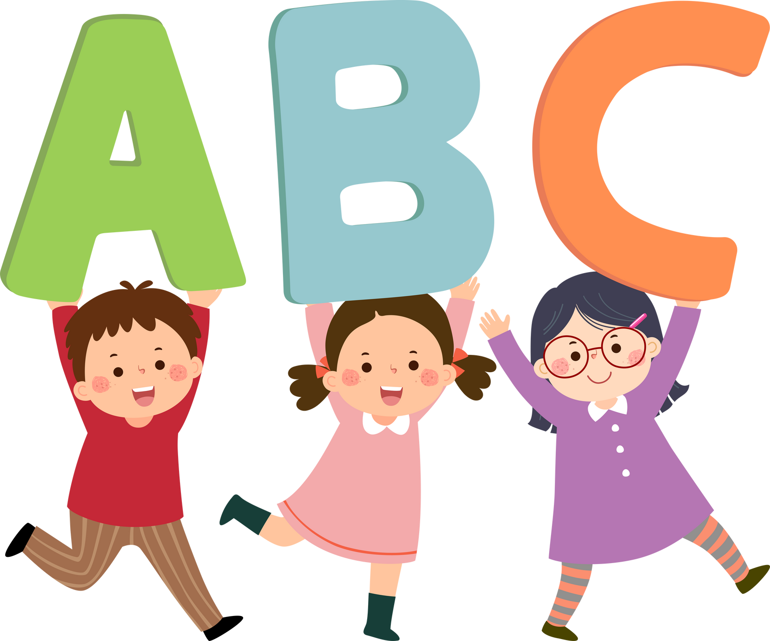
Grade 1
  We can learn English!

Slide 2
Learning Goals
  Greet each other
  Recognize and name animals
  Recognize and name colors
  Name numbers

Slide 3
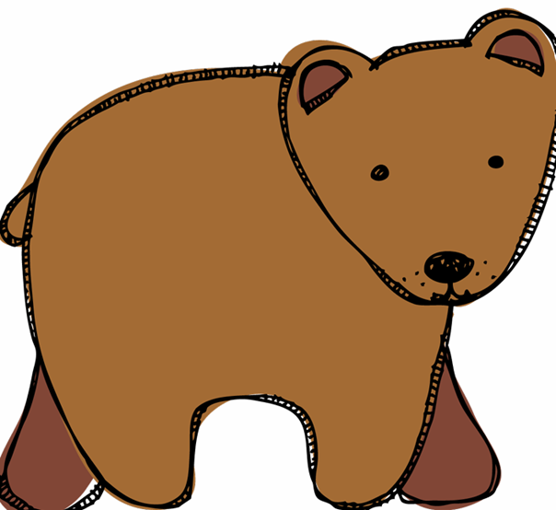
Learn
We can name animals
bear
Notes:
Apple

Slide 4
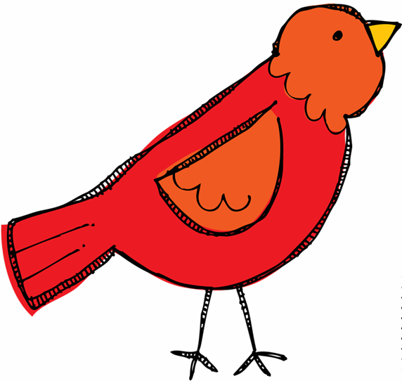
Learn
We can name animals
bird
Notes:
Apple

Slide 5
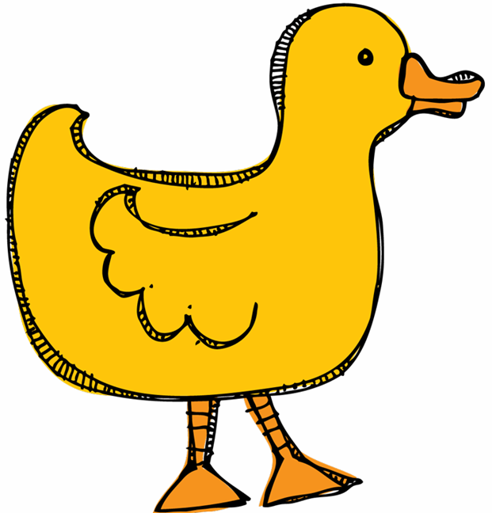
Learn
We can name animals
duck
Notes:
Apple

Slide 6
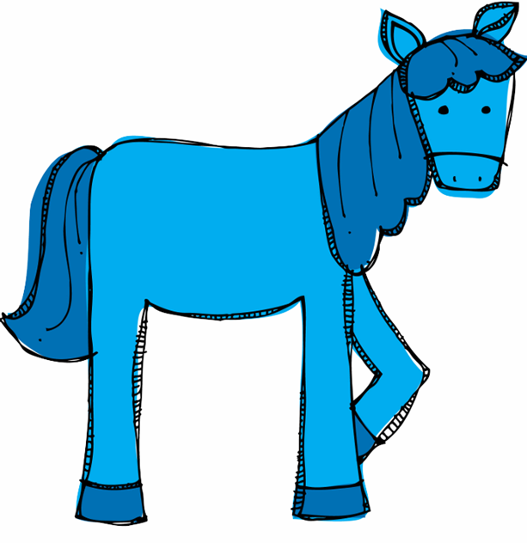
Learn
We can name animals
horse
Notes:
Apple

Slide 7
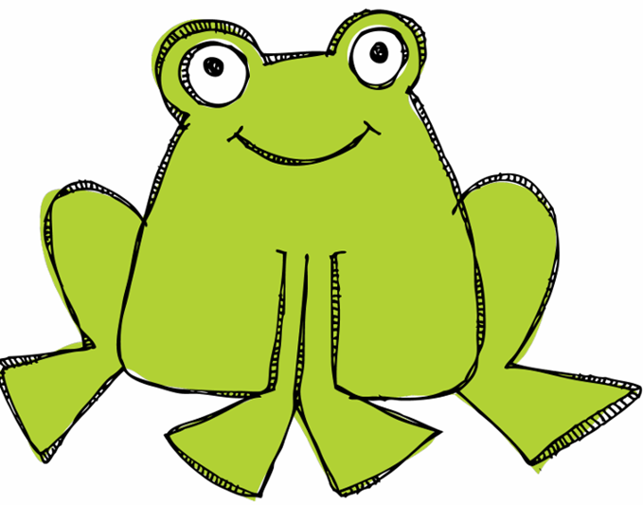
Learn
We can name animals
frog
Notes:
Apple

Slide 8
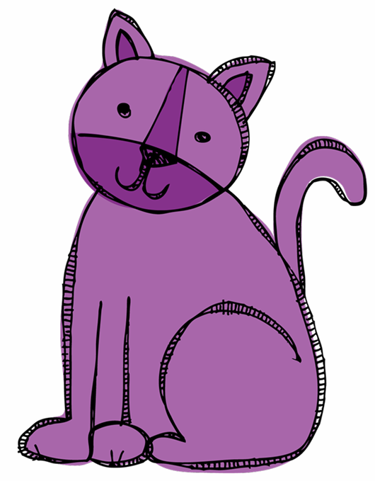
Learn
We can name animals
cat
Notes:
Apple

Slide 9
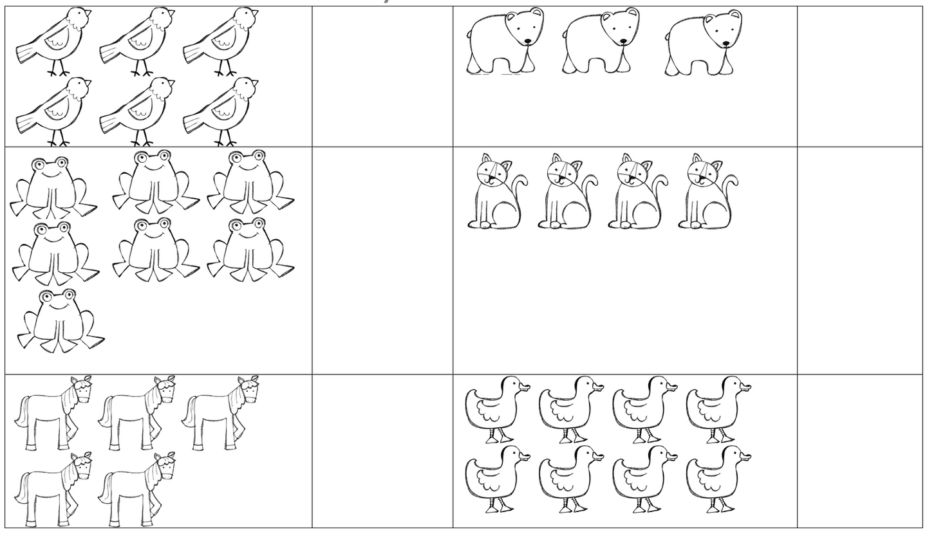
Learn
We can name, color, and count animals
Notes:
Apple

Slide 10
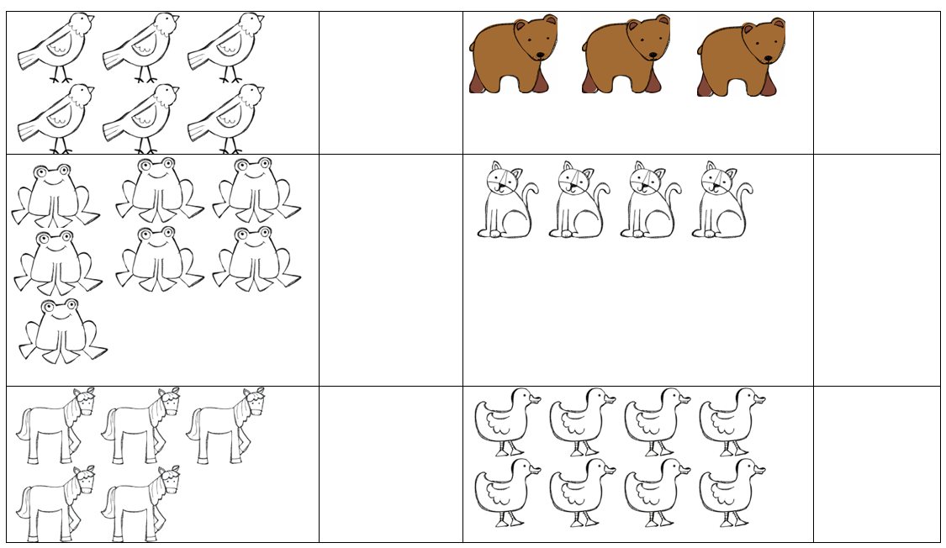
Learn
We can name, color, and count animals
Notes:
Apple

Slide 11
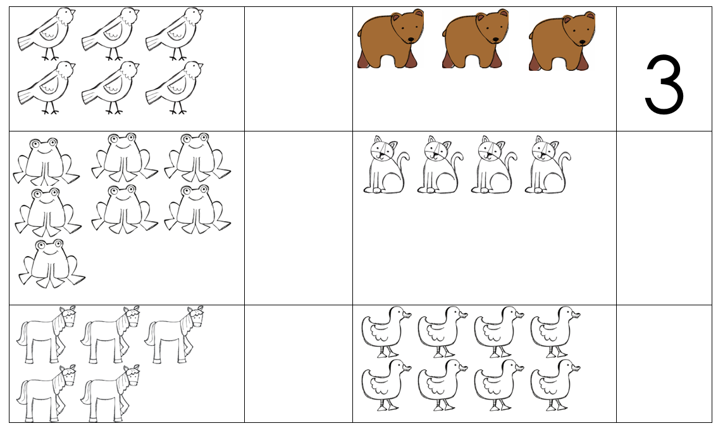
Learn
We can name, color, and count animals
Notes:
Apple

Slide 12
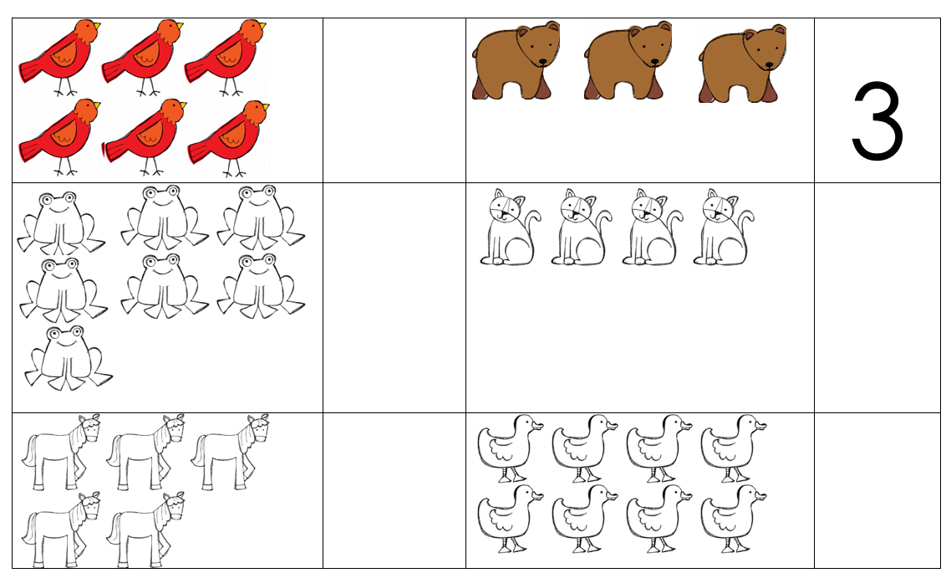
Learn
We can name, color, and count animals
Notes:
Apple

Slide 13
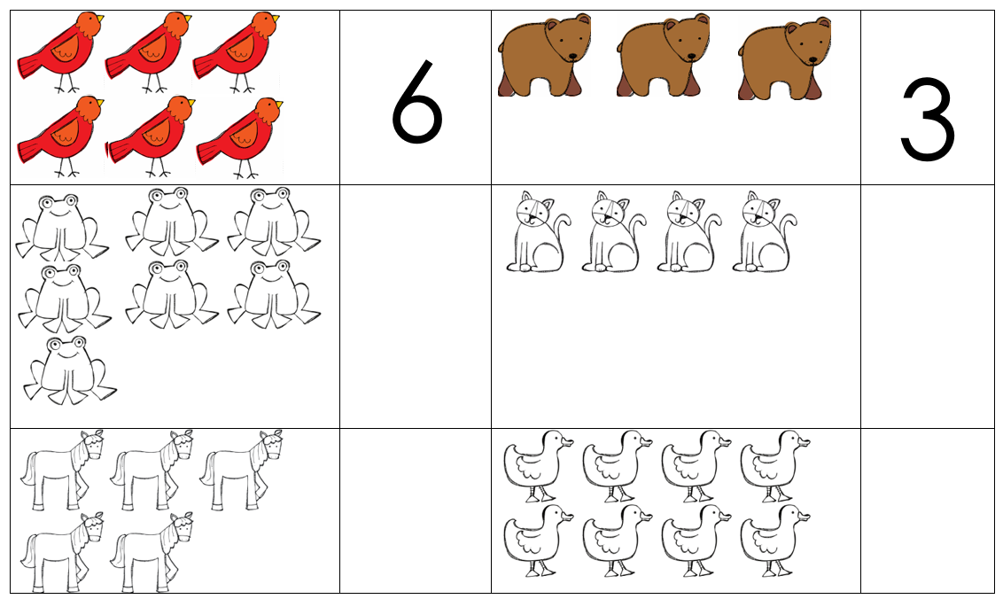
Learn
We can name, color, and count animals
Notes:
Apple

Slide 14
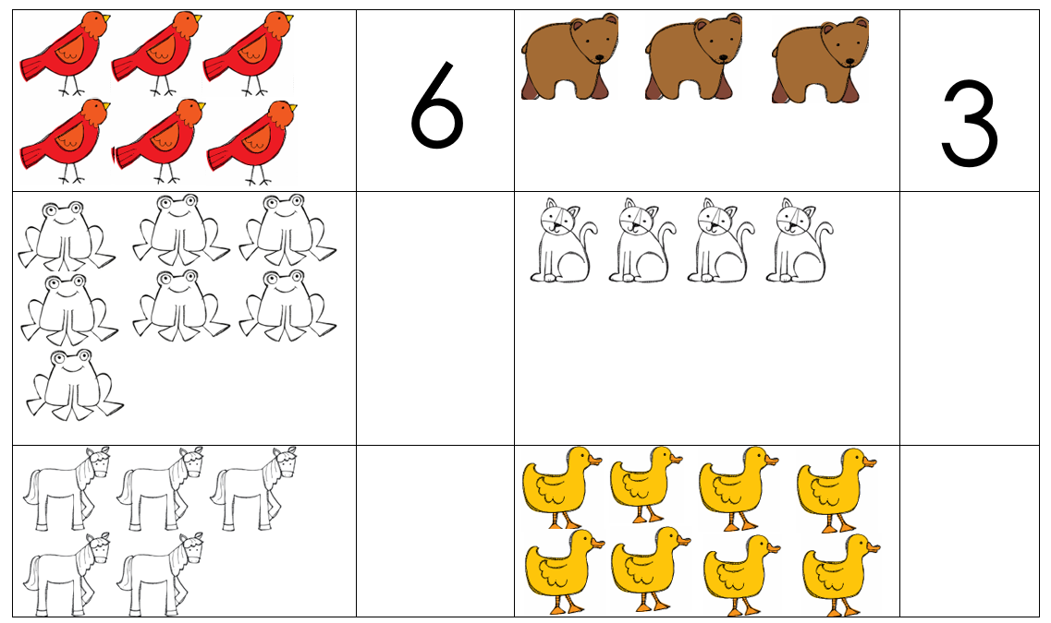
Learn
We can name, color, and count animals
Notes:
Apple

Slide 15
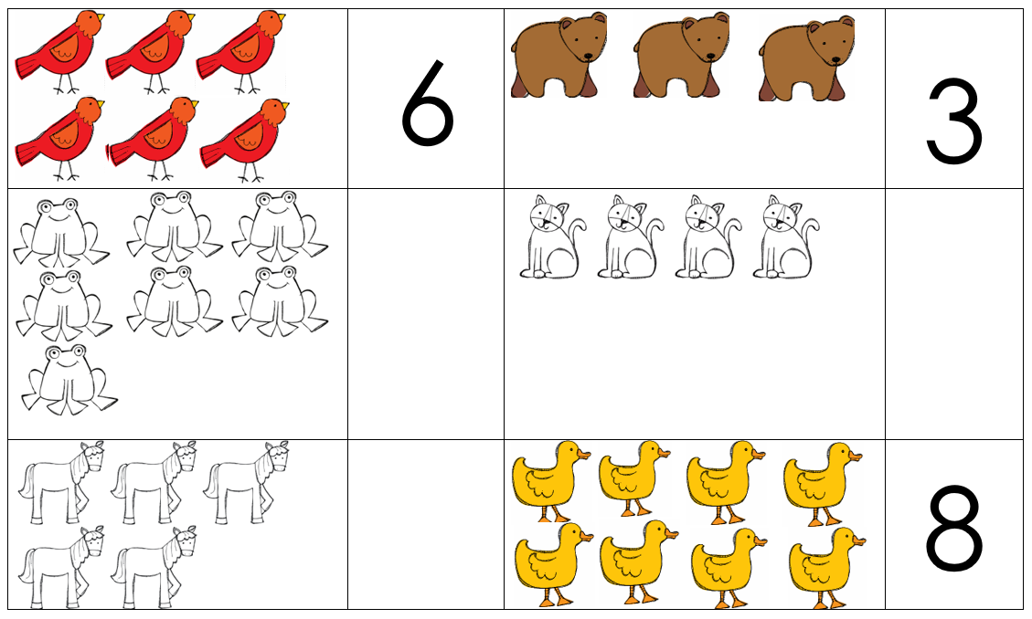
Learn
We can name, color, and count animals
Notes:
Apple

Slide 16
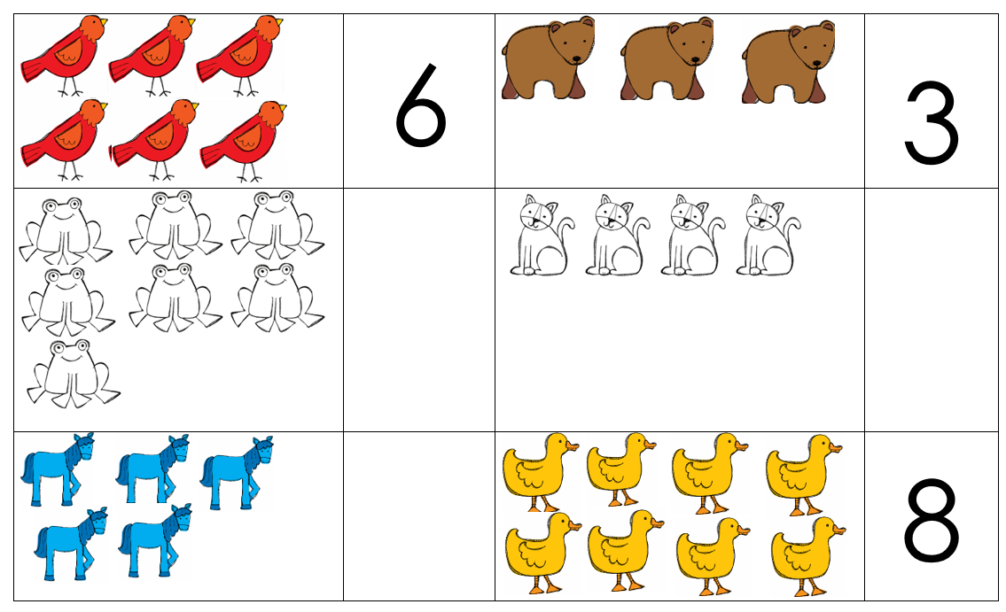
Learn
We can name, color, and count animals
Notes:
Apple

Slide 17
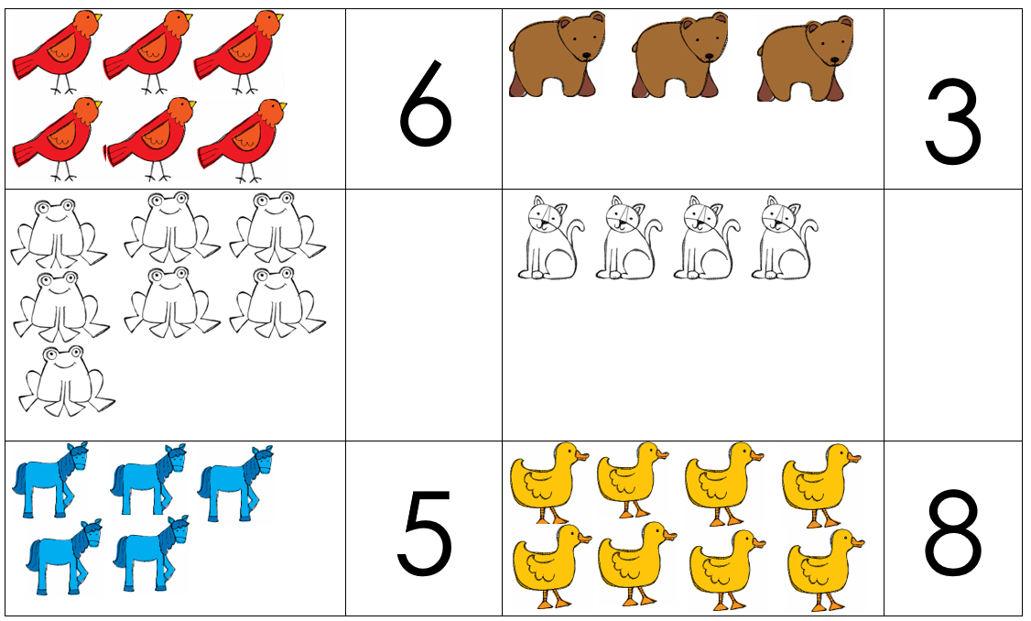
Learn
We can name, color, and count animals
Notes:
Apple

Slide 18
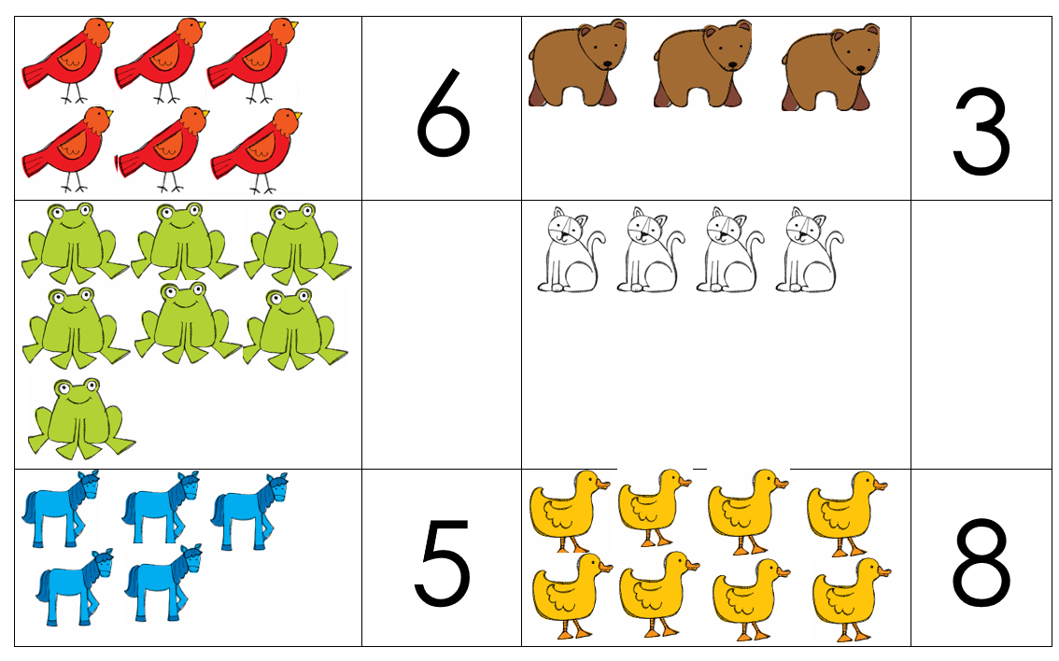
Learn
We can name, color, and count animals
Notes:
Apple

Slide 19
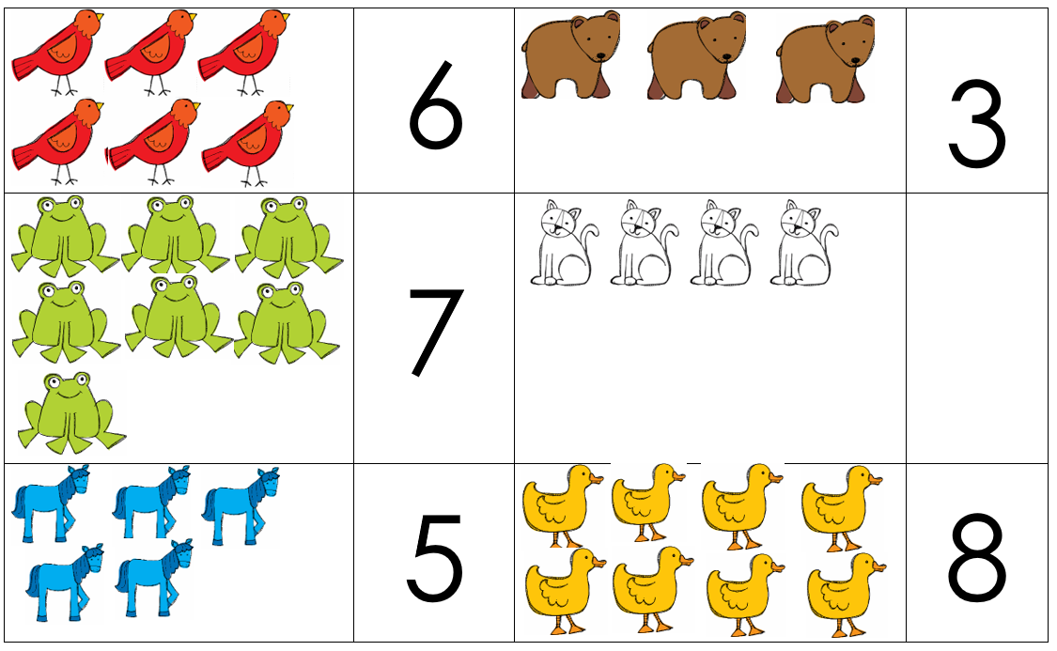
Learn
We can name, color, and count animals
Notes:
Apple

Slide 20
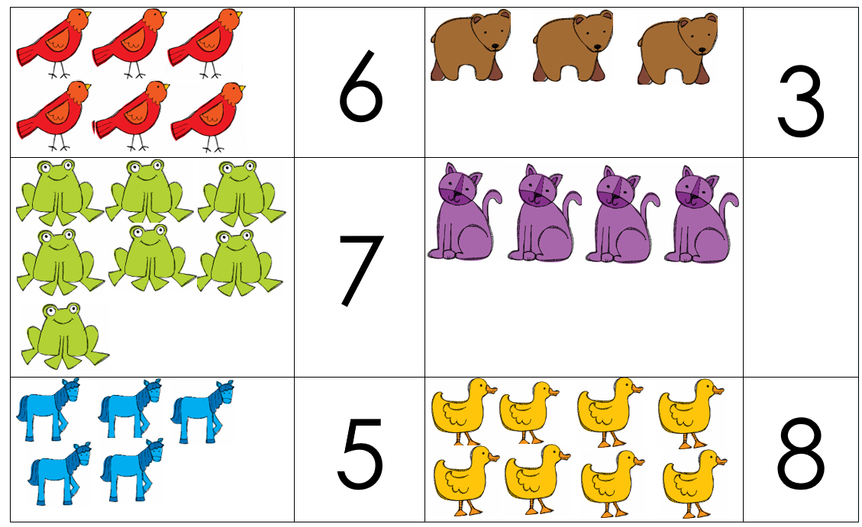
Learn
We can name, color, and count animals
Notes:
Apple

Slide 21
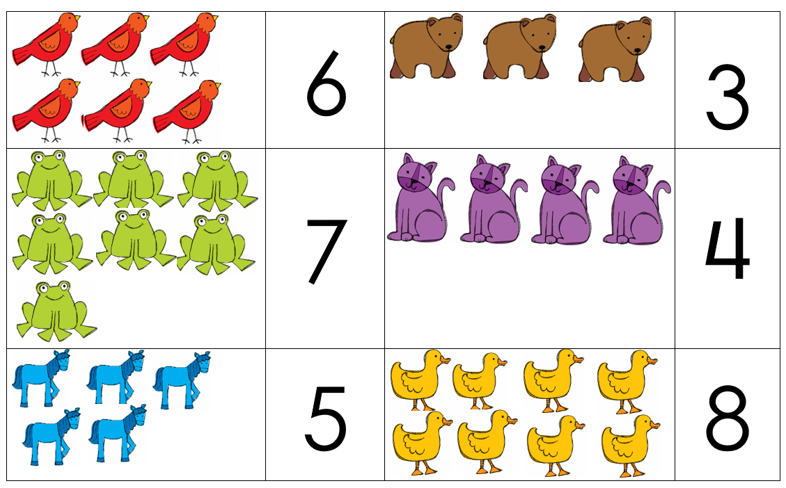
Learn
We can name, color, and count animals
Notes:
Apple

Slide 22
Learn
We can move like animals
Animal movements
Notes:
Zip

Slide 23
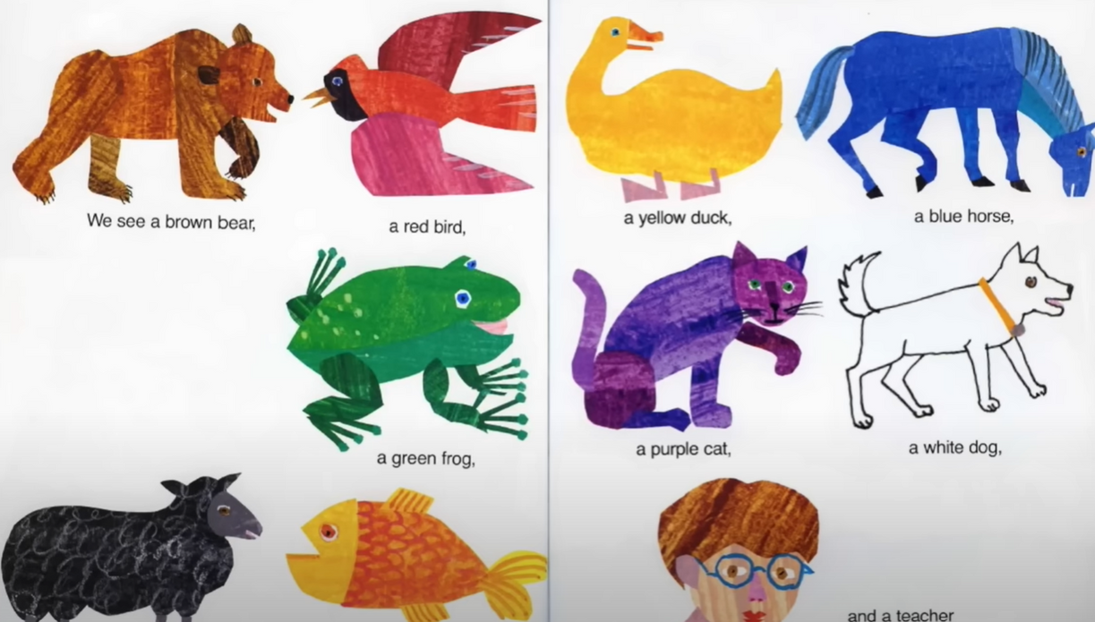
Learn
We can sing about animals
Animal song
Notes:
Zip

Slide 24

Goodbye!
See you next time!
Notes:
Zip

