Slide 1




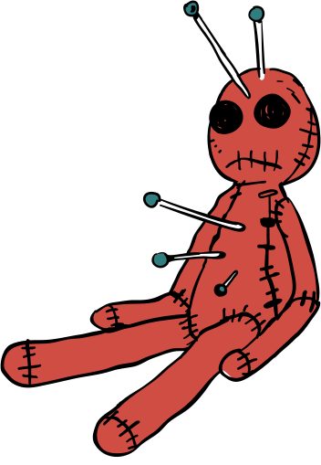

B1 English
  3. Horror Writing

Slide 2
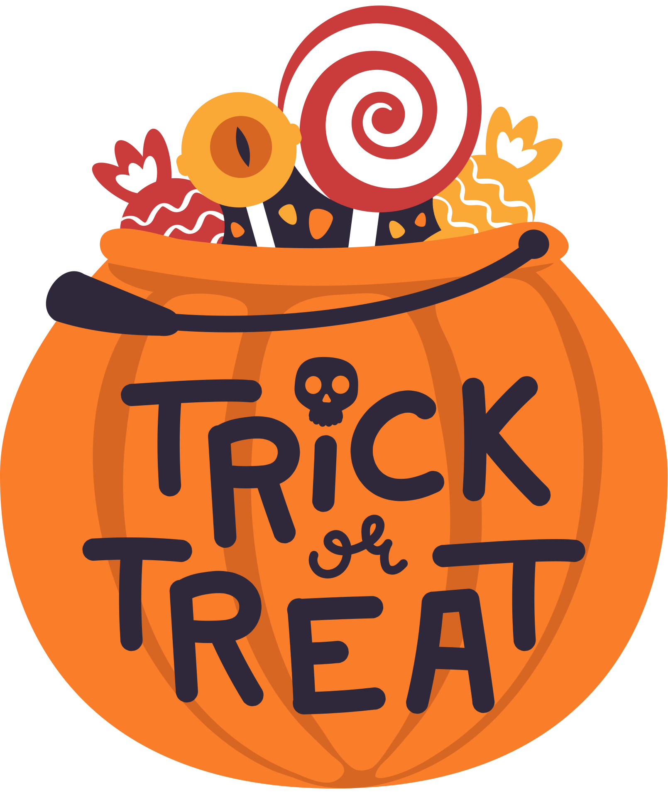
Learning Goals
  Learn and use adjectives in descriptive writing.
  Engage in creative writing with a focus on developing character in horror stories.

Slide 3
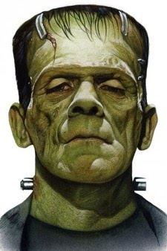
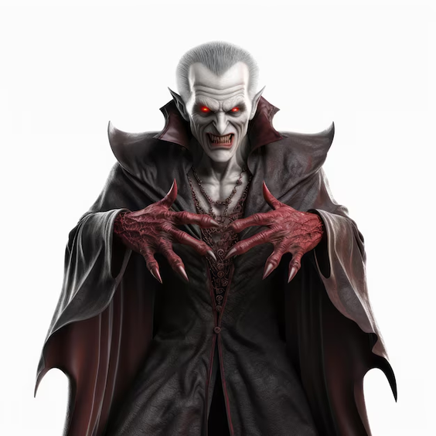
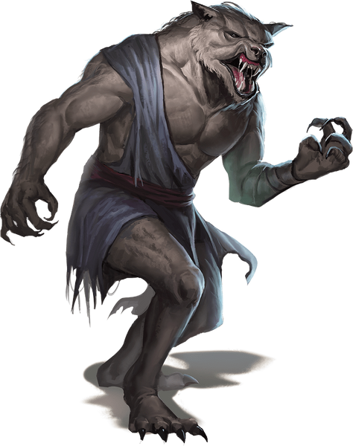
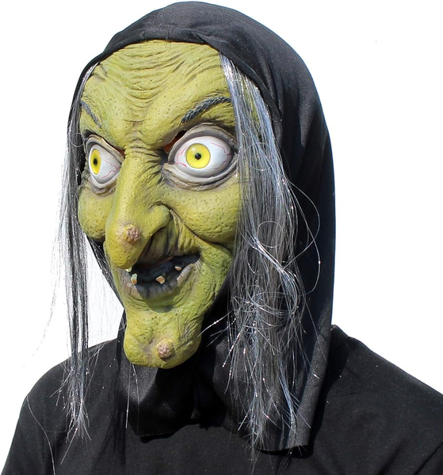



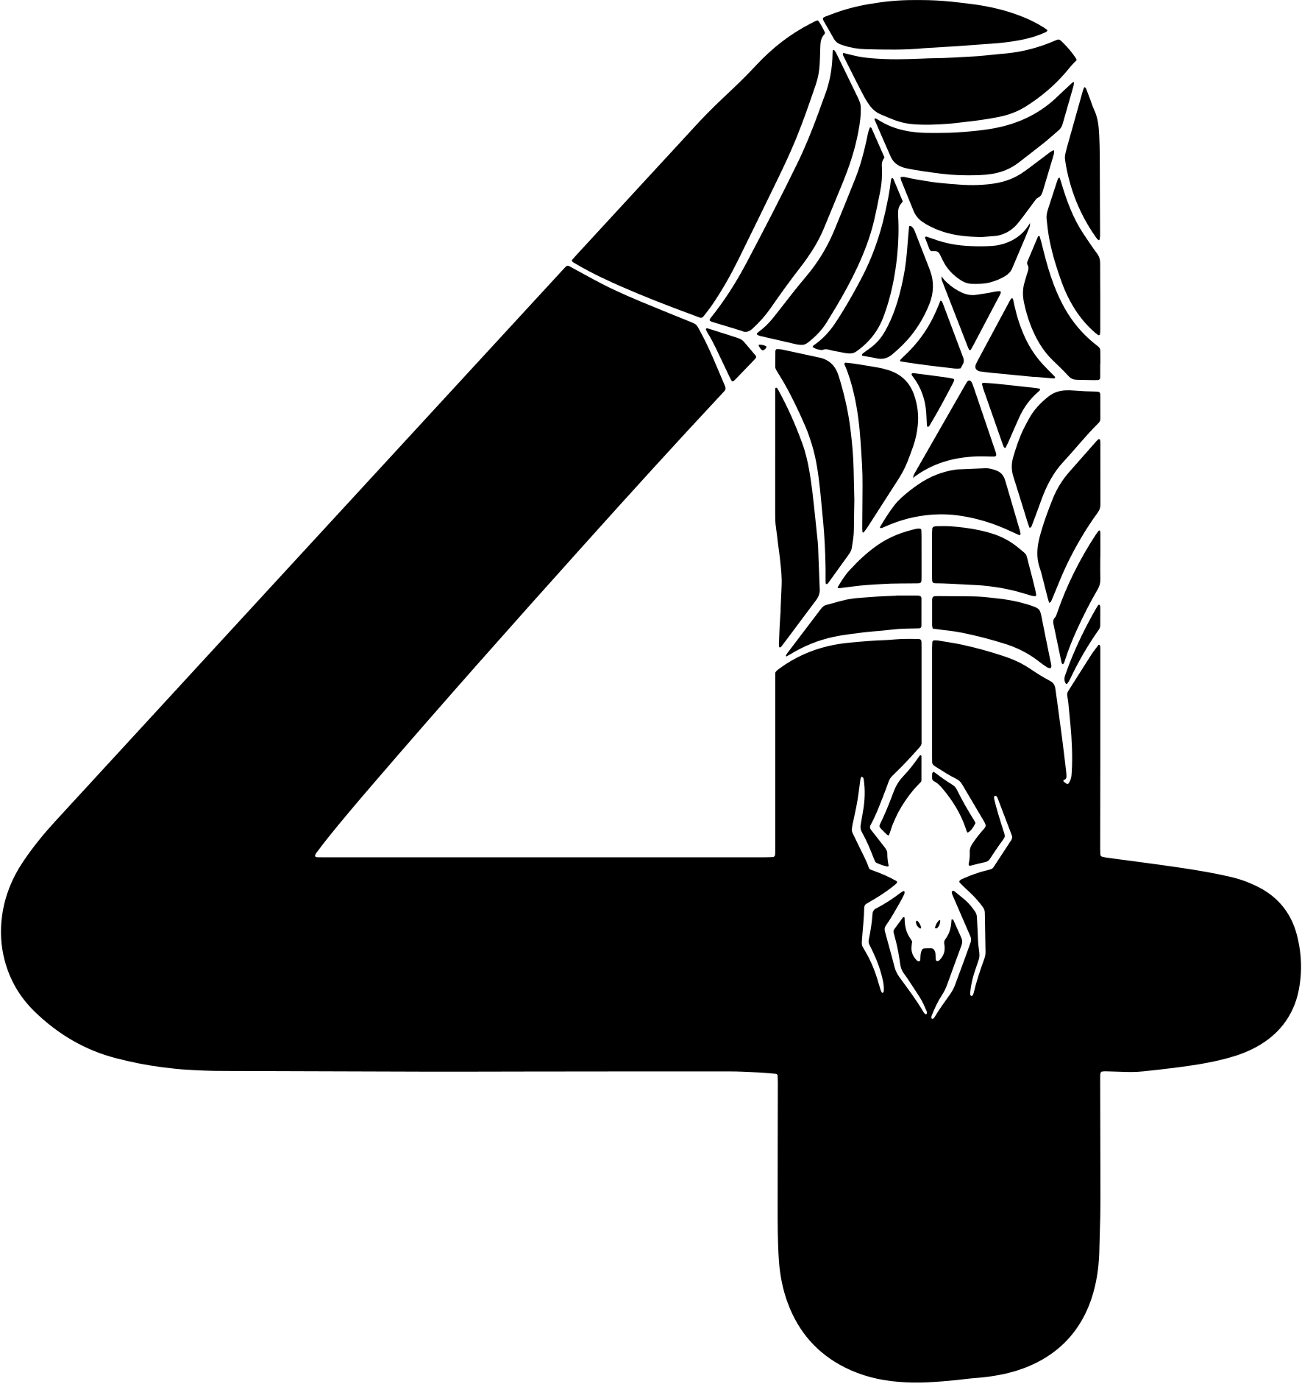
Activate
Describe how these characters look?
Discuss in pairs!! He is..... / She is.....

Slide 4
Feedback
What did you say?! Write any you like!
Frankenstein
dangerous
monster
wild
ugly
strong
rotten
hairy
monstrous
aggressive
terrifying
beastly
pale
evil
vampire
creepy
bloody
wicked
scary
unattractive

Slide 5
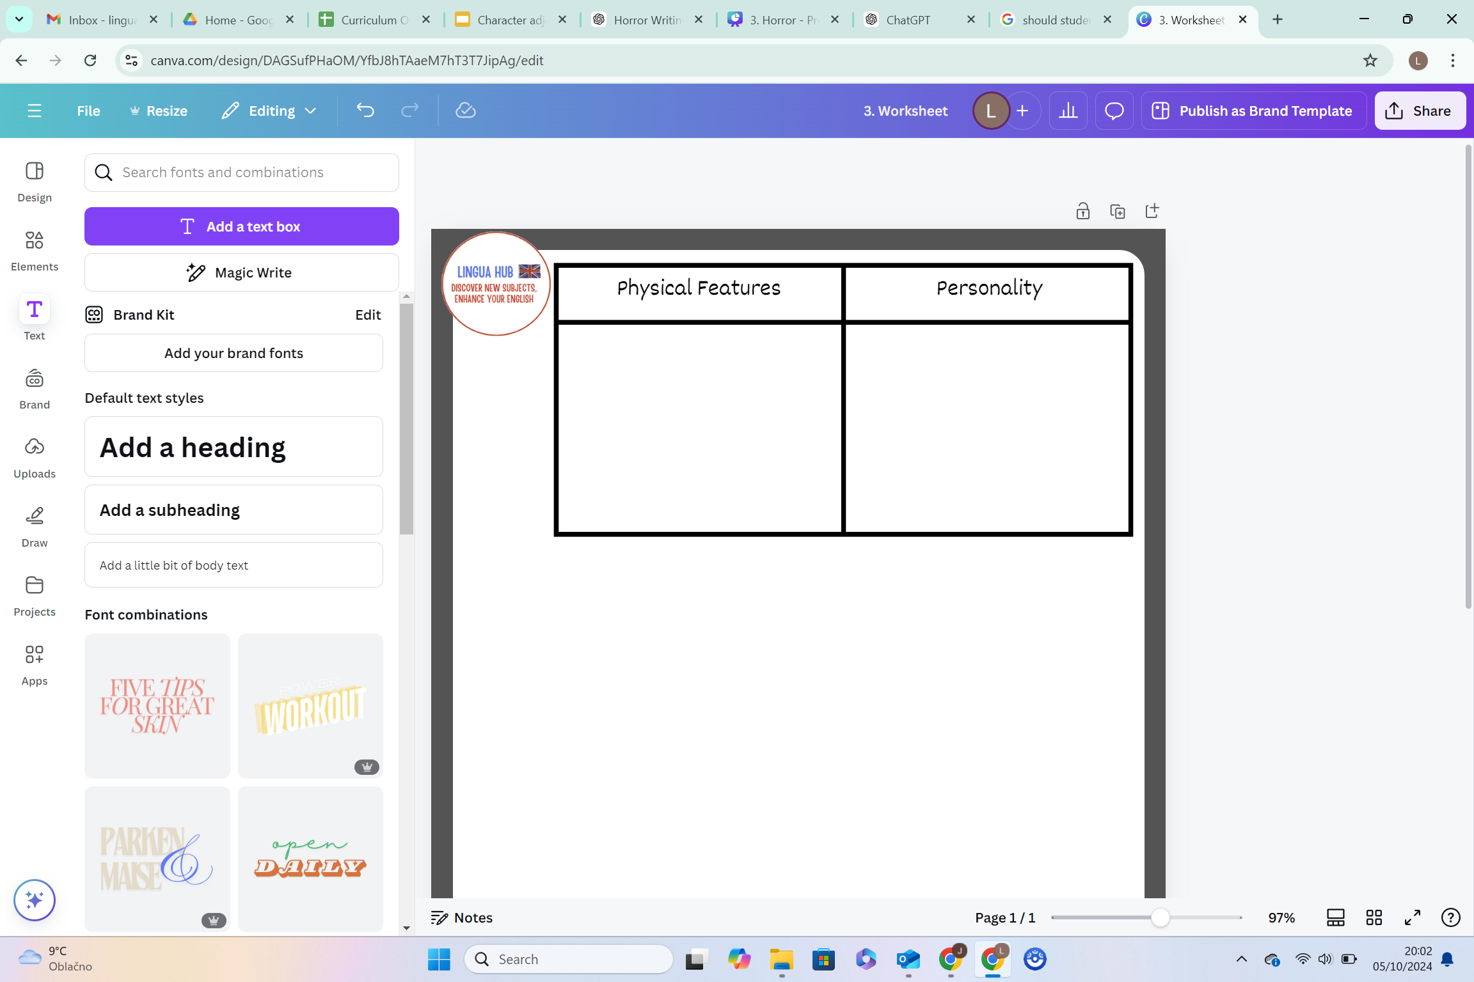
Activity
Categorise the 6 adjectives into 6 personality features and 10 physical features (appearance).
rude
evil
bony
ugly
pale
dangerous
short
sharp teeth
mean
scary looking
skinny
scary
tall
bloody
Graveyard
cruel
hairy

Slide 6
Feedback
Categorise the 16 adjectives into 6 personality features and 10 physical features (appearance).
tall
short
bony
rude
evil
skinny
ugly
pale
mean
dangerous
hairy
bloody
sharp teeth
scary
cruel
scary looking
Graveyard

Slide 7



Check
Which adjective describes appearance (how someone looks)? Vote now! 1, 2 or 3?
Haunted house
mean
scary
ugly
Graveyard

Slide 8

Check
Which adjective describes appearance (how someone looks)?
Haunted house
mean
scary
ugly
The monster was so ugly!
Graveyard

Slide 9
Check
Which adjective describes personality? Vote now! 1, 2 or 3?
Haunted house
sharp teeth
scary
scary looking
Graveyard

Slide 10
Check
Which adjective describes personality? Vote now! 1, 2 or 3?
Haunted house
sharp teeth
scary
scary looking
Graveyard
The monster was so scary!

Slide 11
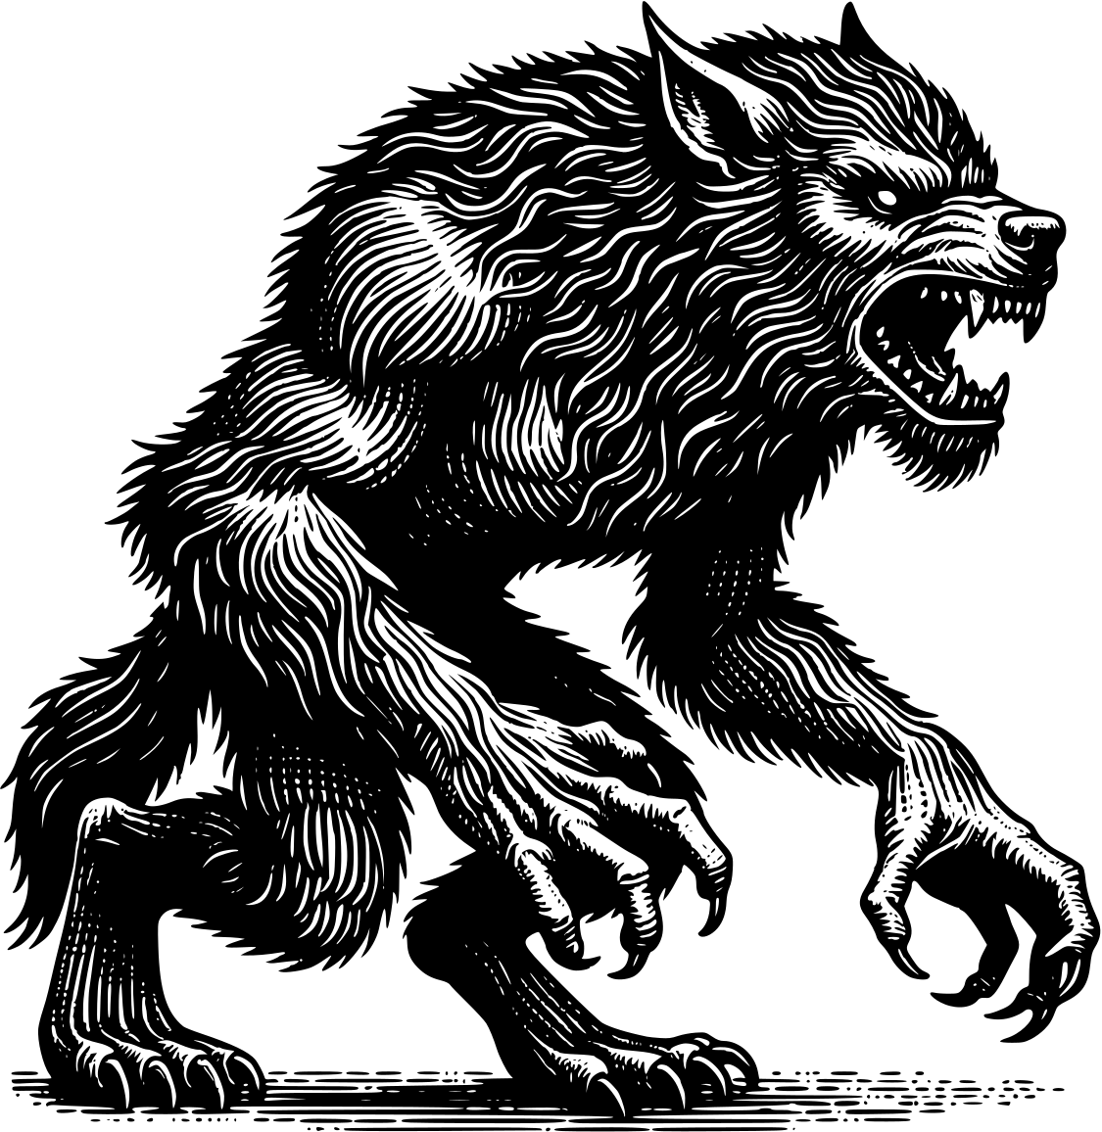
Activity
Describe this character. Choose the correct 3 adjectives!
The werewolf is ................... and ................ with .................... teeth.
skinny
Sharp
hairy
muscular
fat
bony

Slide 12
Activity
Describe this character. Choose the correct 3 adjectives!
muscular
The werewolf is ................... and ................ with .................... teeth.
hairy
Sharp
skinny
fat
bony

Slide 13
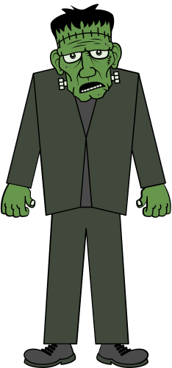
Activity
Describe this character. Choose the correct 3 adjectives!
The monster is ................... and ................ with .................... skin.
scary-looking
Sharp
green
ugly
fat
bony

Slide 14
Activity
Describe this character. Choose the correct 3 adjectives!
scary-looking
The monster is ........................... and ................ with .................... skin.
ugly
green
Sharp
fat
bony

Slide 15
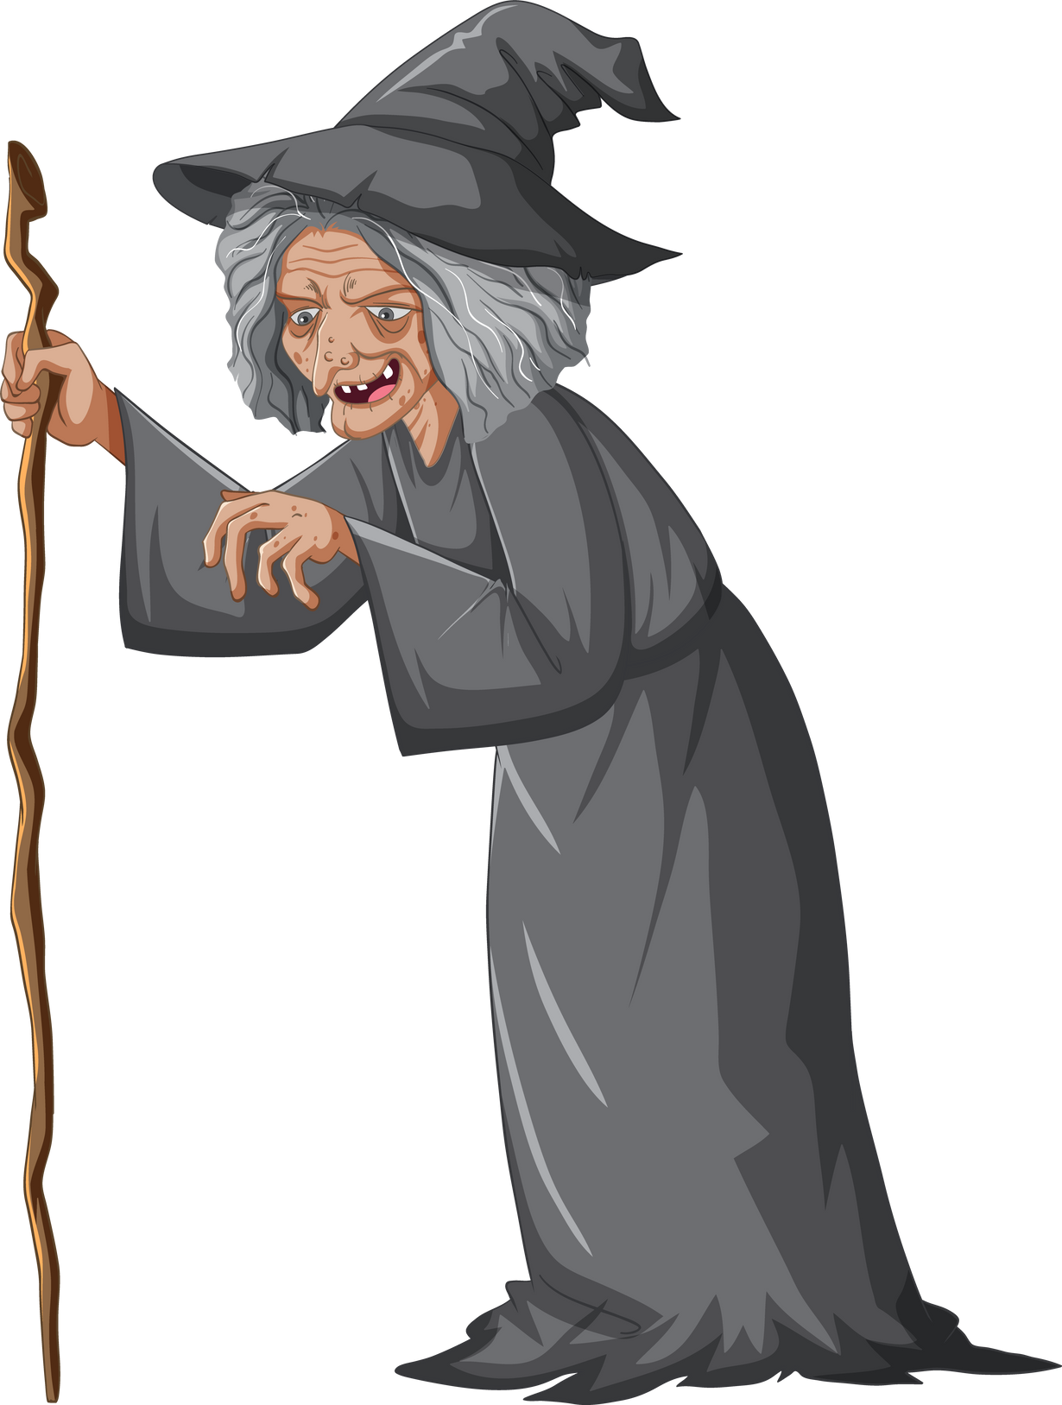
Activity
Describe this character. Discuss for 30 seconds and think of 3 adjectives.
The witch is ...................

Slide 16
Activity
Describe this character. Discuss for 30 seconds and think of 3 adjectives.
The witch is ...................
scary-looking
wrinkled skin
old
evil
mean
nasty
grey hair

Slide 17
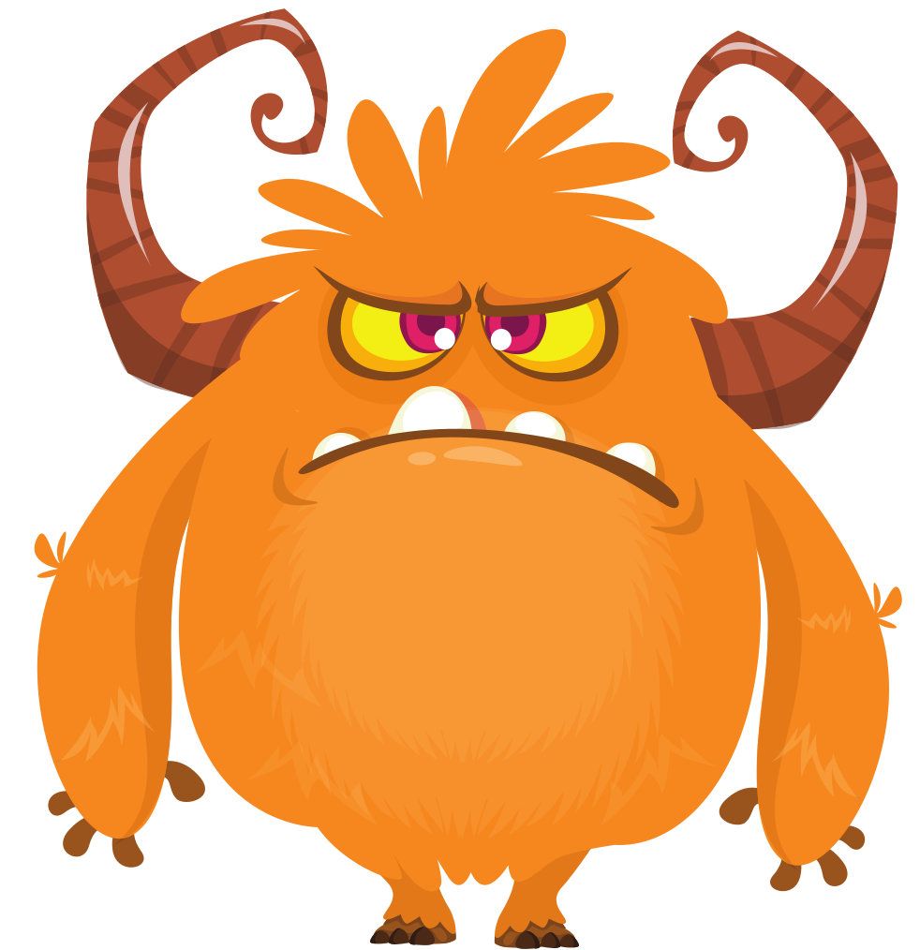
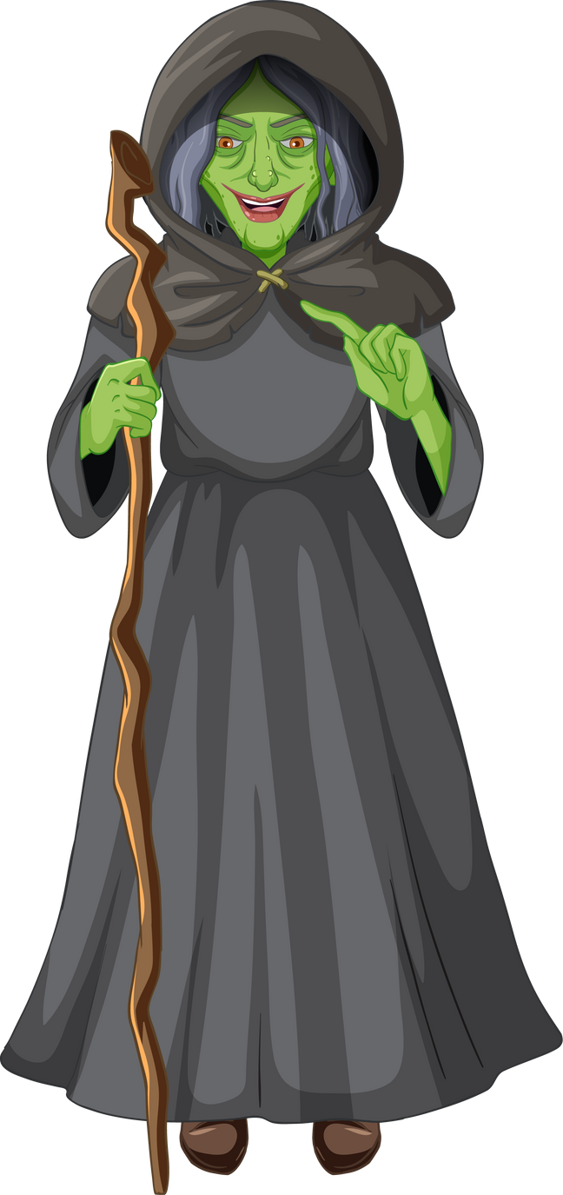
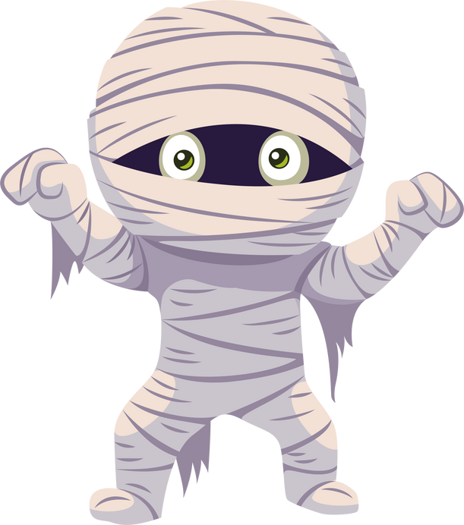
Activity
Create your own character. Discuss for 2 minutes your ideas.
  What does your character look like?
  What is your character’s personality?

Slide 18

Activity
Draw your own character and label its features.
Red eyes
Example:
Grey hair
Green skin
Nasty
Skinny
Old
Witch
Evil
Stick
Black clothes
Scary

Slide 19
Activity
Write three sentences about your charcter.
Example:
Red eyes
My character is an old, evil witch.
She is skinny with green skin, red eyes and grey hair.
She is evil and scary.
Grey hair
Green skin
Evil
Old
Skinny
Scary
Witch
Stick
Black clothes
My character is a....
He/she/it is....
Nasty

Slide 20

Activity
Ask your partner questions about your character. Describe your character to your partner.
  What colour is your character?
  What does he/she/it look like?
  Is your character mean or nice?

Slide 21
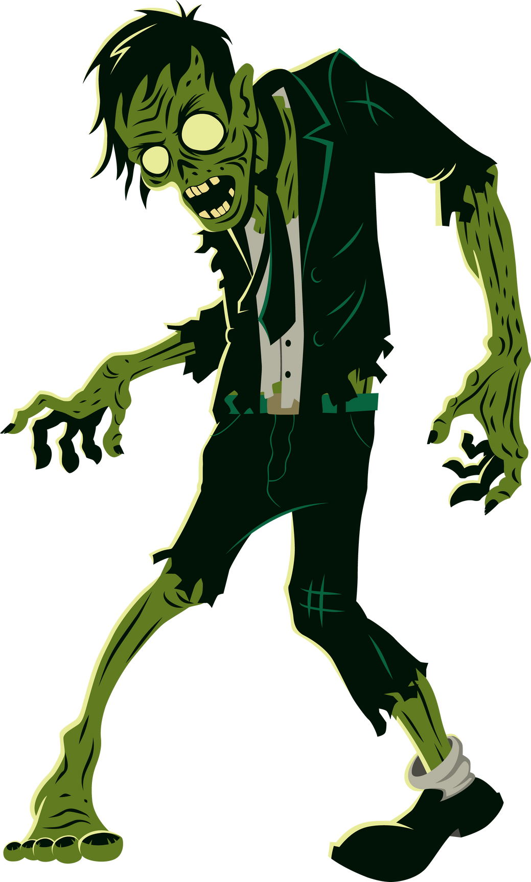
Role play
Act as if you are your character. Rest of the class will vote who was the scariest!!
As you act, you must also describe your character and use adjectives.
Example:
I am a big, scary green zombie!!

