Slide 1



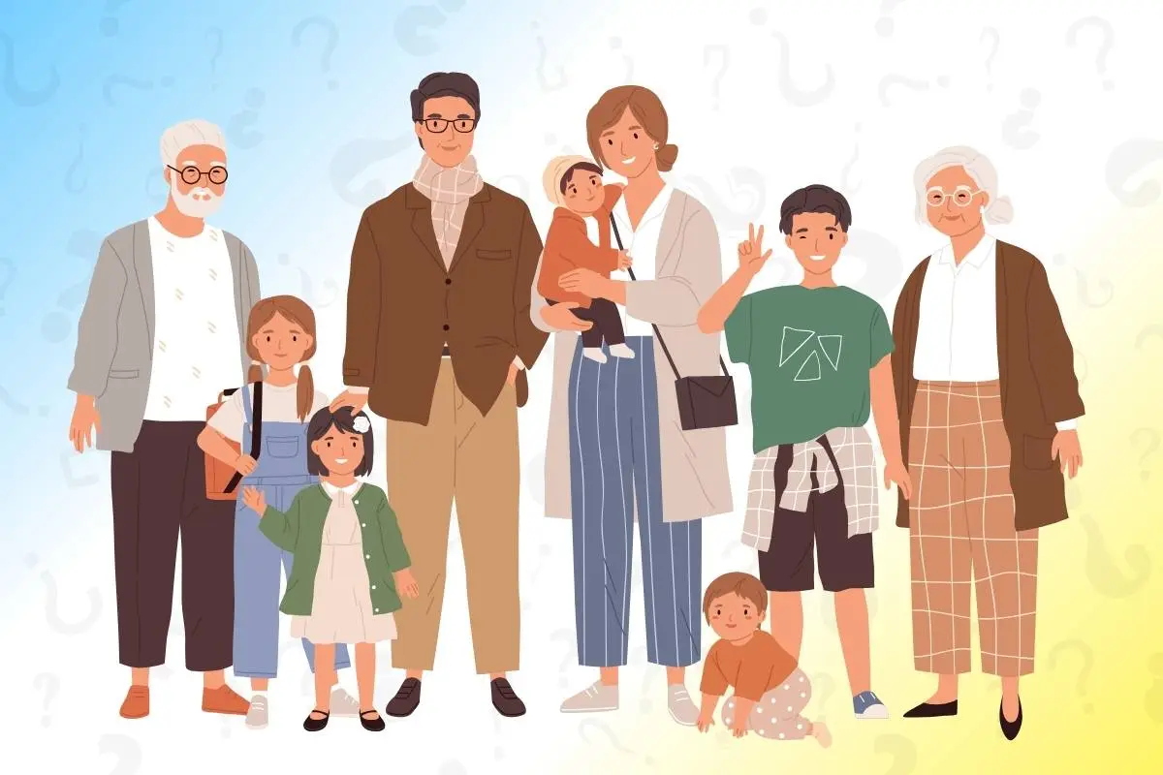
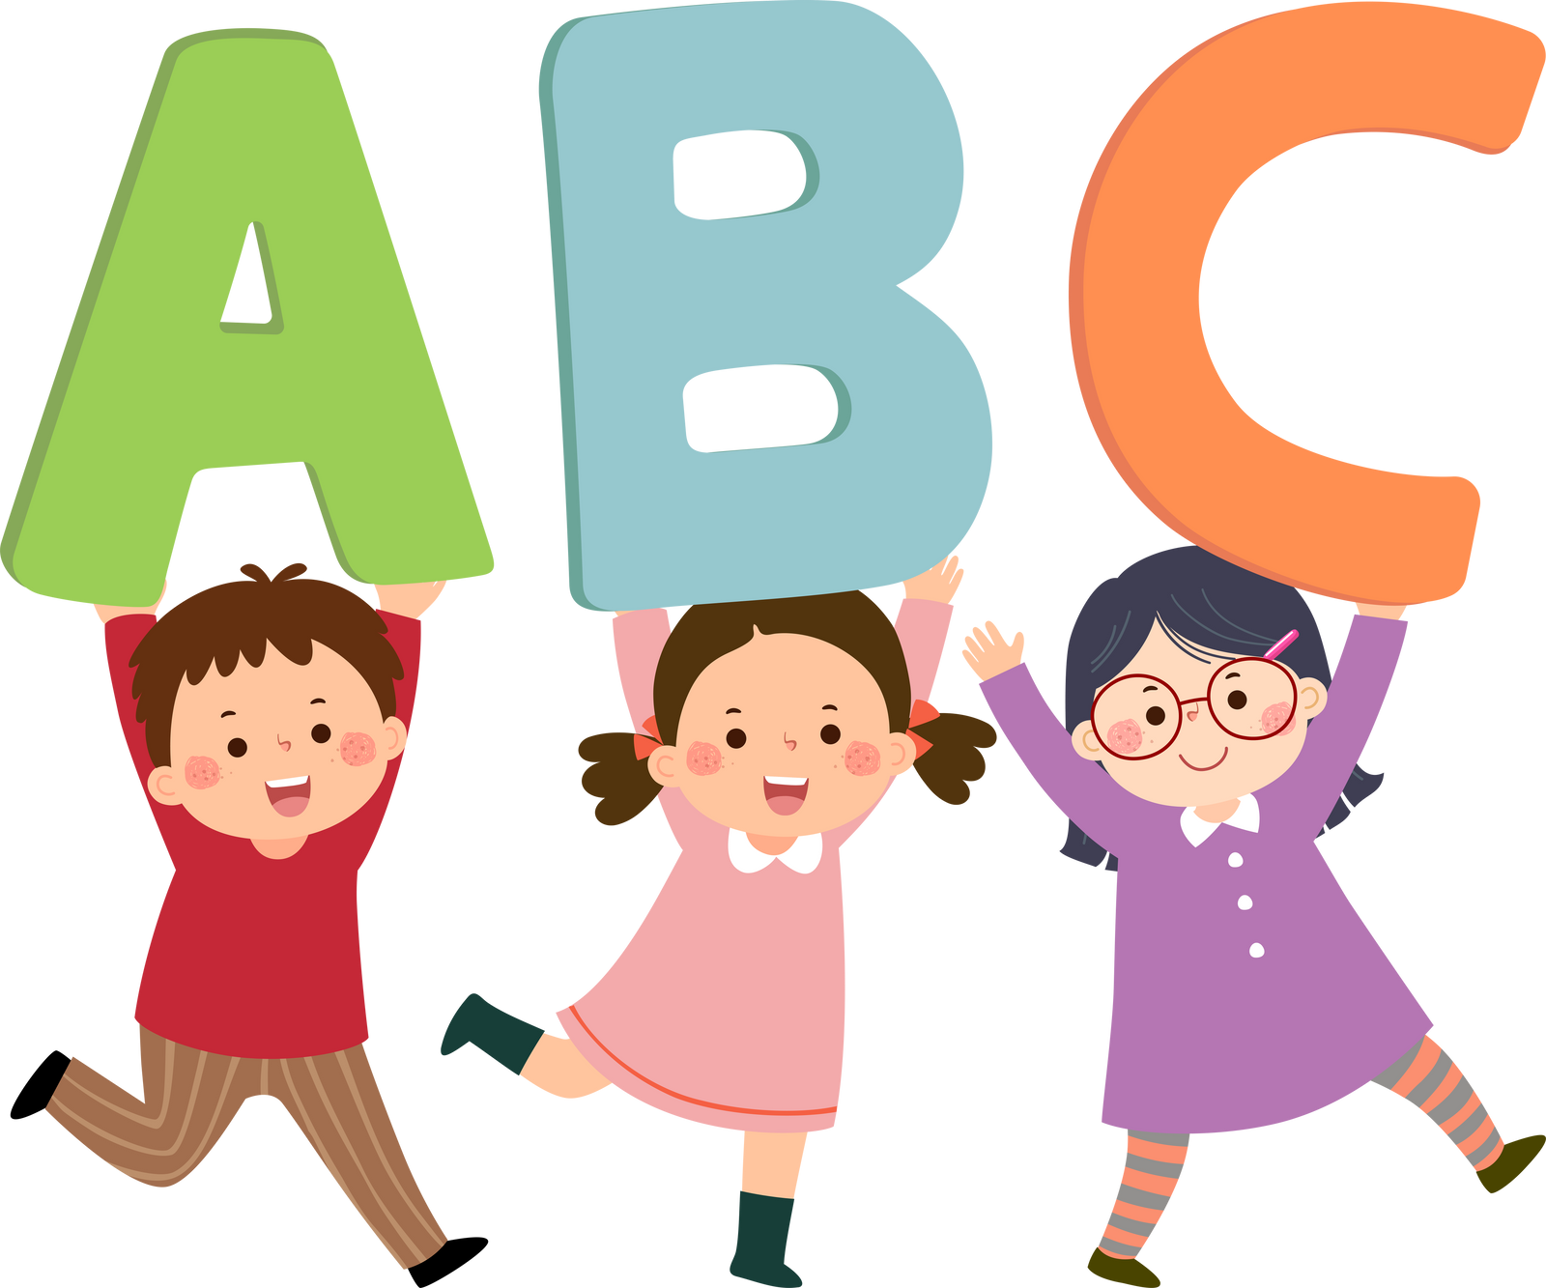
Grade 3-4
  5. Family (rodina)

Slide 2
Learning Goals
  Learn key words connected to family and family members
  Practice being able to ask and answer who is in your family.

Slide 3
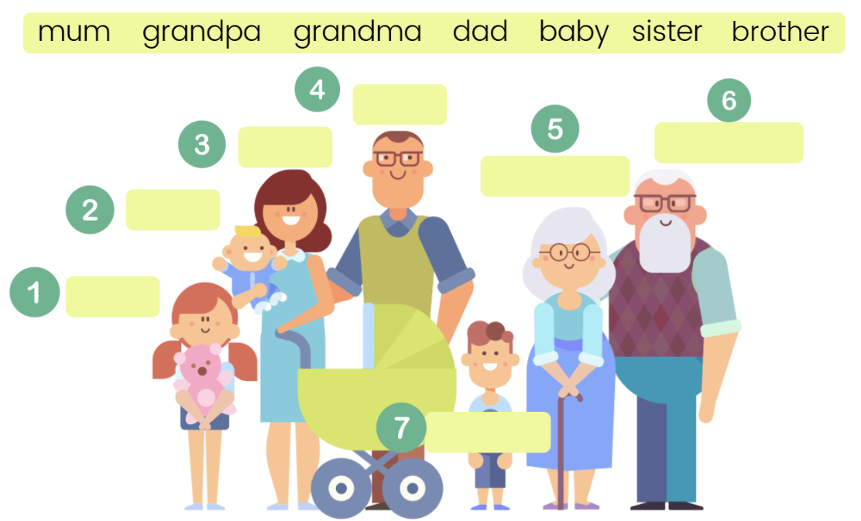
Activate
How many do you know?
As a class, can we match 1-7 to the correct family member
sister

Slide 4
Answers
How many do you know?
1 = sister
2 = baby
3 = mother
4 = father
5 = grandma
6 = grandpa
7 = brother

Slide 5
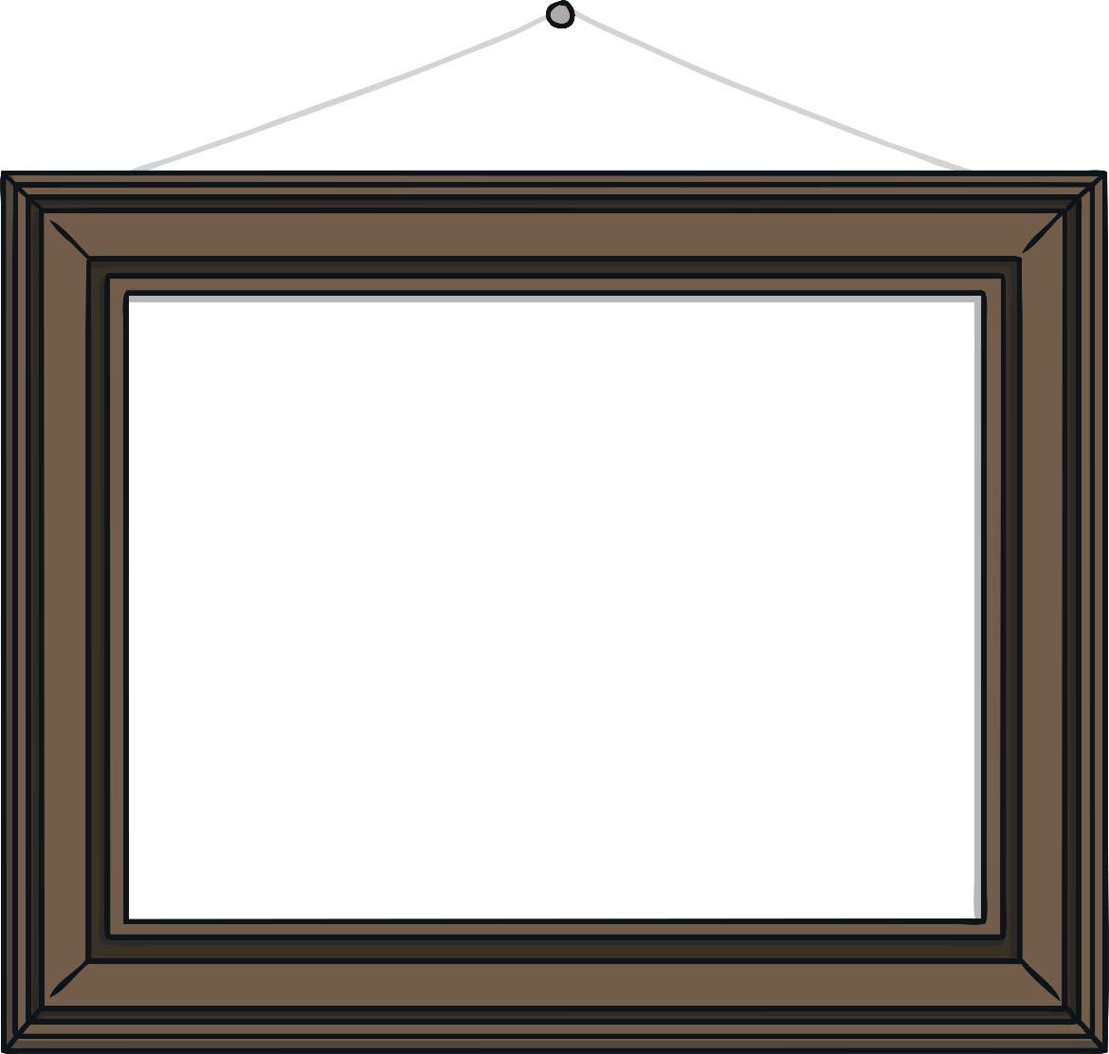
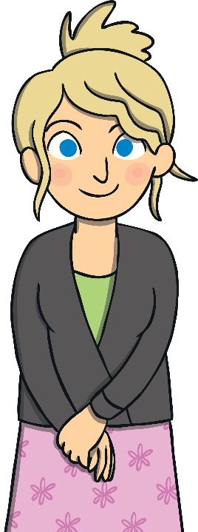
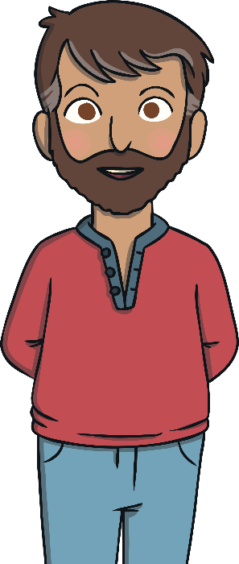
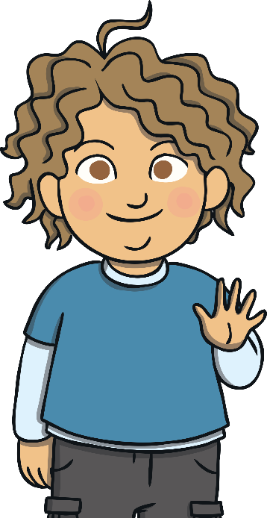
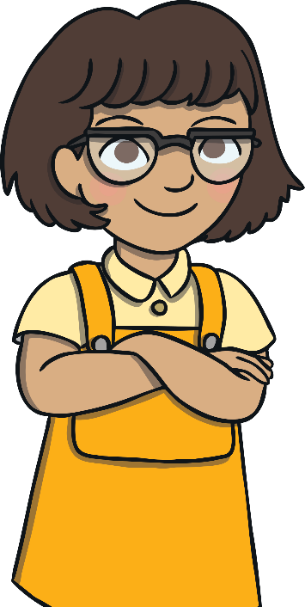
Learn
Who is in your family?
Repeat after me
I have a…
Mother =
Matka
Father =
Otec
Brother =
Bratr
Sister =
Sestra

Slide 6
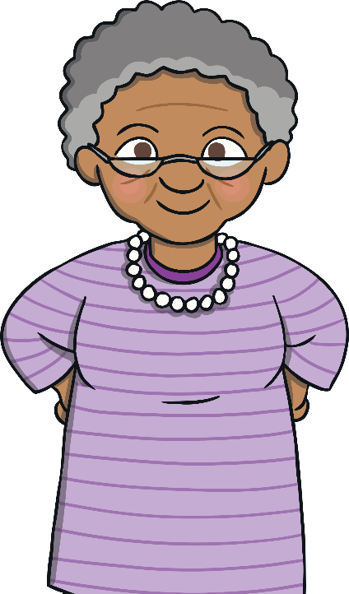
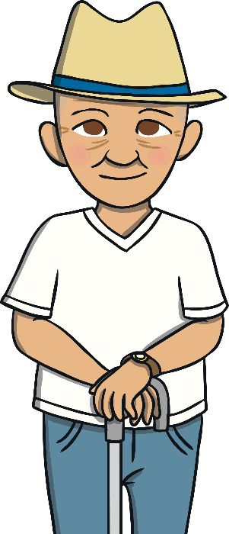
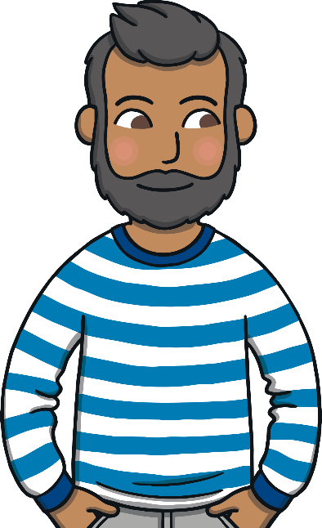
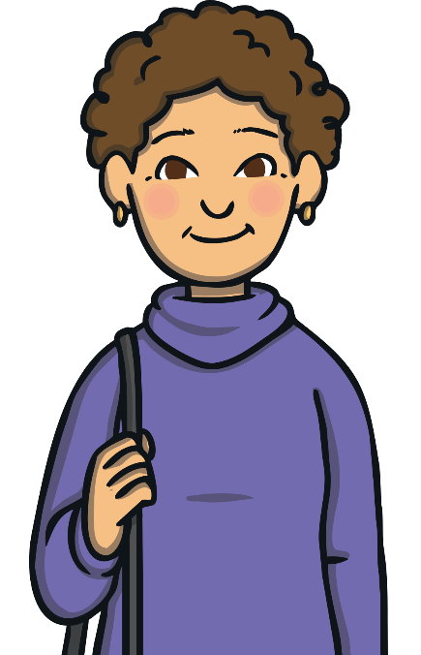
Learn
Who is in your family?
I also have a…
Grandmother =
babička
Grandfather =
dědeček
Uncle =
strýc
Aunt =
teta

Slide 7
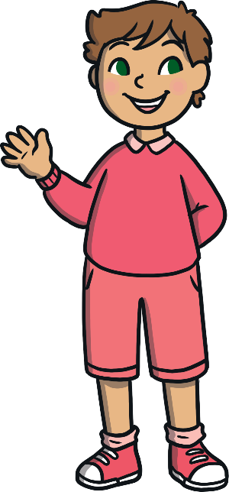
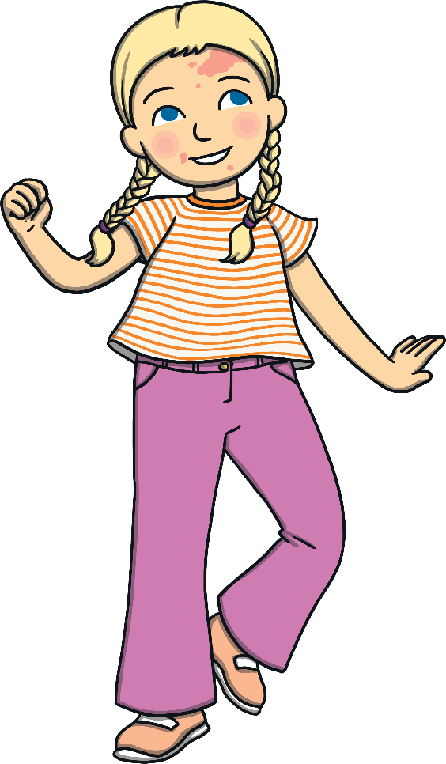
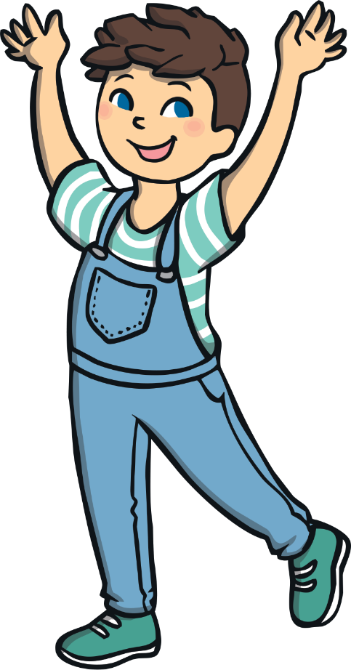
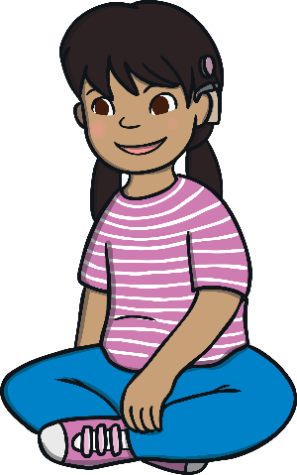
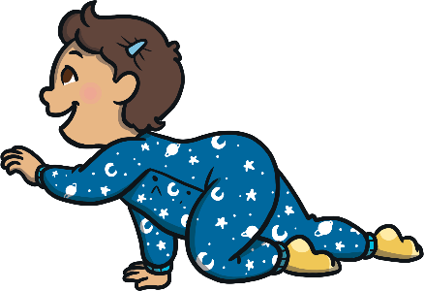
Learn
Who is in your family?
I also have…
Cousins =
bratranec
Nieces and nephews =
neteře a synovci

Slide 8
This is my family
Learn
Mother = Matka
Father = Otec
Brother = Bratr
Sister = Sestra
Cousins =
bratranec
Grandmother = babička
Grandfather = dědeček
Uncle = strýc
Aunt = teta
Nieces and nephews
neteře a synovci

Slide 9
Game
In the next slides, 1 family member will be missing.
Can you spot it?!
Raise your hand, and say which is missing?! You get a point!

Slide 10
This is my family
Game
Father = Otec
Brother = Bratr
Sister = Sestra
Cousins =
bratranec
Grandmother = babička
Grandfather = dědeček
Uncle = strýc
Aunt = teta
Nieces and nephews
neteře a synovci

Slide 11
This is my family
Learn
Mother = Matka
Father = Otec
Brother = Bratr
Cousins =
bratranec
Grandmother = babička
Grandfather = dědeček
Uncle = strýc
Aunt = teta
Nieces and nephews
neteře a synovci

Slide 12
This is my family
Learn
Mother = Matka
Father = Otec
Brother = Bratr
Sister = Sestra
Cousins =
bratranec
Grandmother = babička
Uncle = strýc
Aunt = teta
Nieces and nephews
neteře a synovci

Slide 13
This is my family
Learn
Mother = Matka
Brother = Bratr
Sister = Sestra
Cousins =
bratranec
Grandmother = babička
Grandfather = dědeček
Uncle = strýc
Aunt = teta
Nieces and nephews
neteře a synovci

Slide 14
This is my family
Game
Mother = Matka
Father = Otec
Sister = Sestra
Cousins =
bratranec
Grandmother = babička
Grandfather = dědeček
Uncle = strýc
Aunt = teta
Nieces and nephews
neteře a synovci

Slide 15
This is my family
Game
Mother = Matka
Father = Otec
Brother = Bratr
Sister = Sestra
Cousins =
bratranec
Grandmother = babička
Grandfather = dědeček
Uncle = strýc
Nieces and nephews
neteře a synovci

Slide 16
This is my family
Game
Mother = Matka
Father = Otec
Brother = Bratr
Sister = Sestra
Cousins =
bratranec
Grandfather = dědeček
Uncle = strýc
Aunt = teta
Nieces and nephews
neteře a synovci

Slide 17
This is my family
Game
Mother = Matka
Father = Otec
Brother = Bratr
Sister = Sestra
Grandmother = babička
Grandfather = dědeček
Uncle = strýc
Aunt = teta
Nieces and nephews
neteře a synovci

Slide 18
This is my family
Game
Mother = Matka
Father = Otec
Brother = Bratr
Sister = Sestra
Cousins =
bratranec
Grandmother = babička
Grandfather = dědeček
Aunt = teta
Nieces and nephews
neteře a synovci

Slide 19
This is my family
Game
Brother = Bratr
Sister = Sestra
Cousins =
bratranec
Grandmother = babička
Grandfather = dědeček
Uncle = strýc
Aunt = teta
Nieces and nephews
neteře a synovci

Slide 20
This is my family
Game
Mother = Matka
Father = Otec
Brother = Bratr
Sister = Sestra
Cousins =
bratranec
Grandmother = babička
Grandfather = dědeček
Uncle = strýc
Aunt = teta

Slide 21
This is my family
Game
Mother = Matka
Father = Otec
Cousins =
bratranec
Grandmother = babička
Grandfather = dědeček
Uncle = strýc
Aunt = teta
Nieces and nephews
neteře a synovci

Slide 22
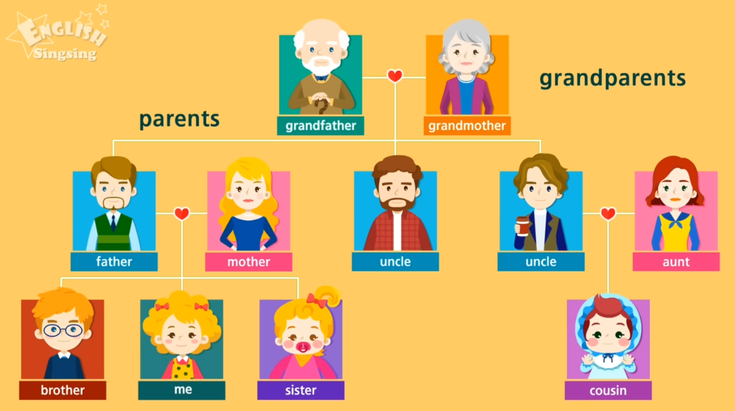
Video
Watch the video to learn more

Slide 23
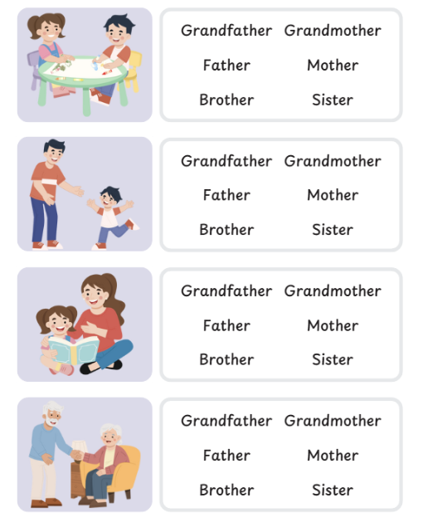
Activity
Circle the names of the family members that you see

Slide 24
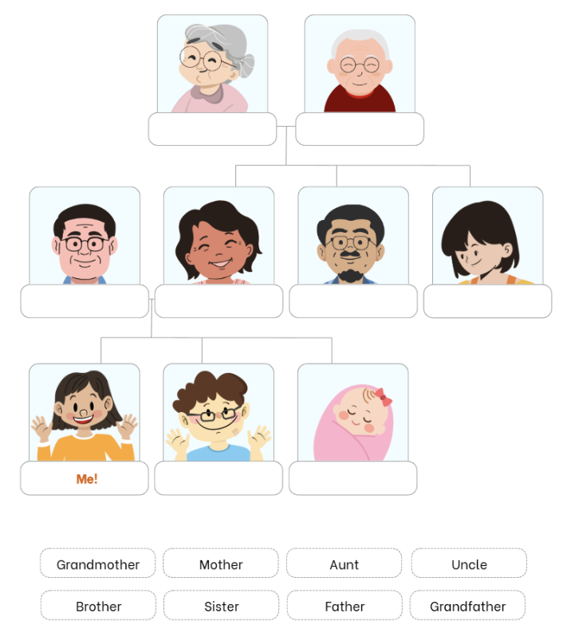
Activity
Write the correct names of the family members

Slide 25
Answers
Grandmother
Grandfather
Father
Mother
Uncle
Auntie
Brother
Sister

Slide 26
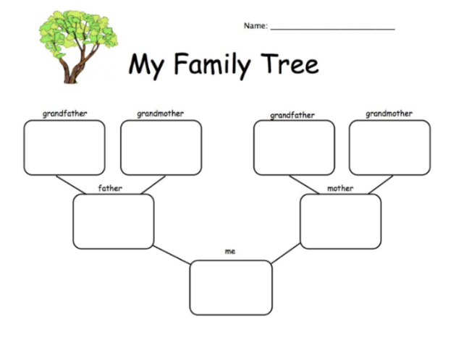
Activity
Complete a family tree about yourself
Draw and colour simple pictures of your family members
Label names
Brother / Sister?
Brother / Sister?

Slide 27
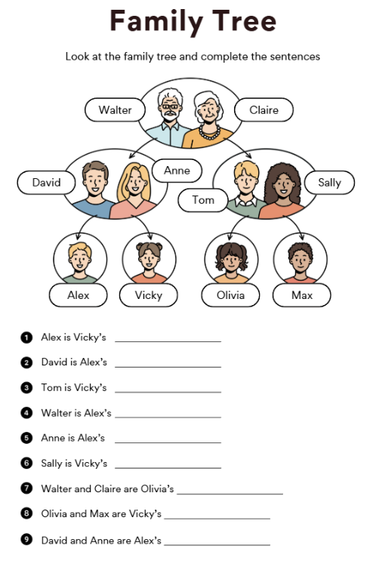
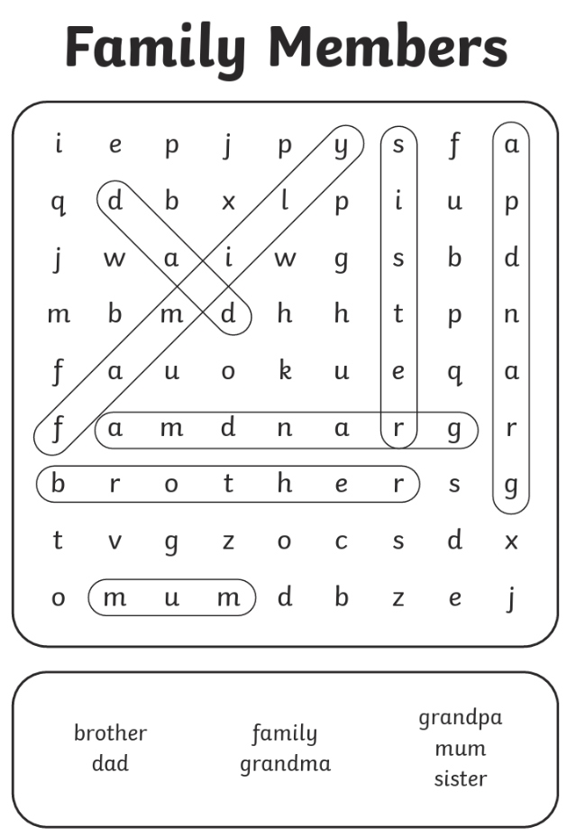
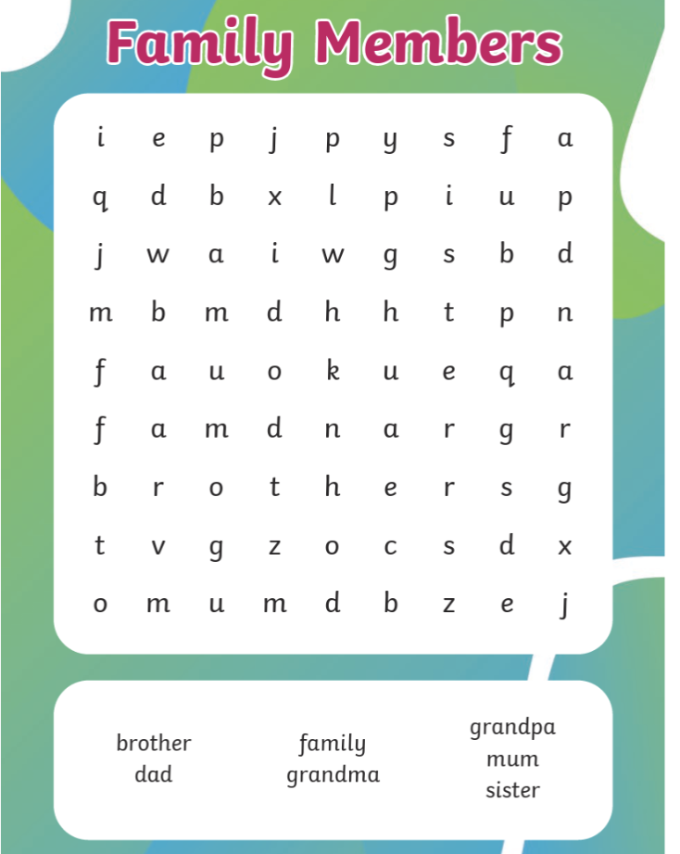
Challenge
Try the challenge (left) or the wordsearch to finish

Slide 28
Answers

