Slide 1



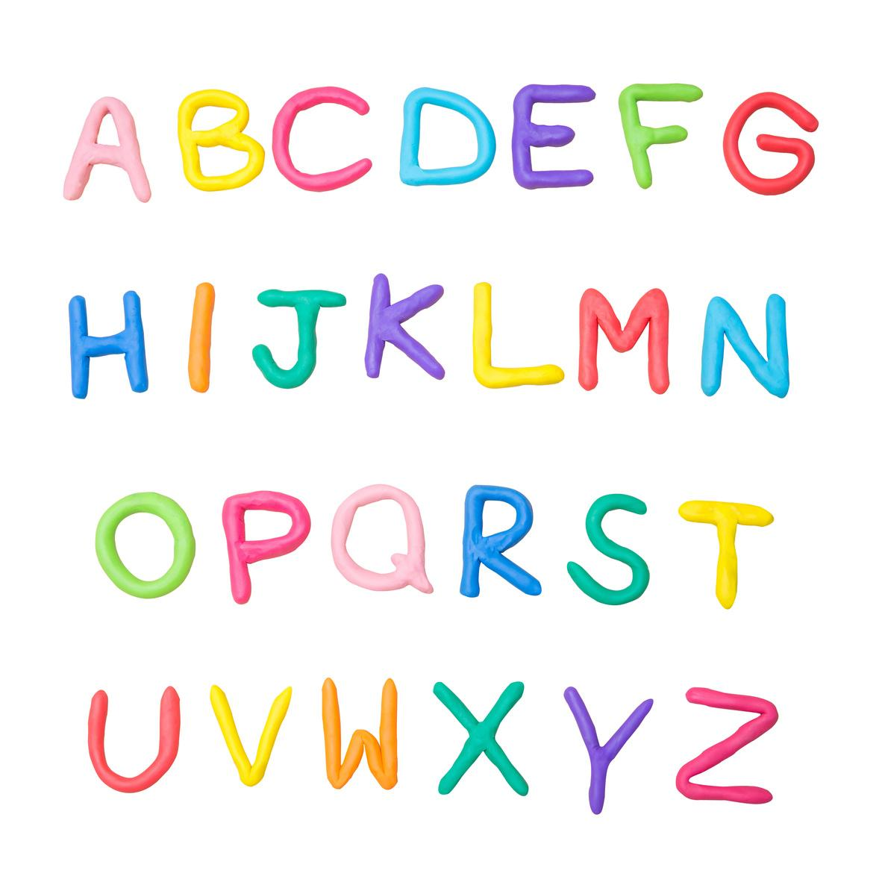
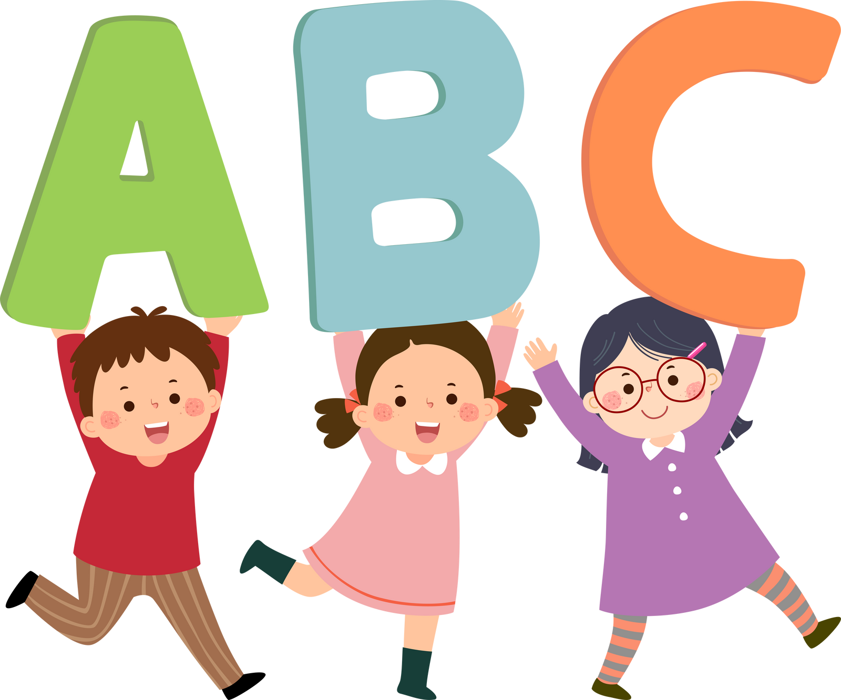
Grade 1-2
  We can learn English!

Slide 2
Learning Goals
  Greet each other
  Recognise and pronounce numbers 0-10
  Recognise and name seasons and clothes

Slide 3
Activate
How many numbers do you know?
0 1 2 3 4 5
6 7 8 9 10

Slide 4
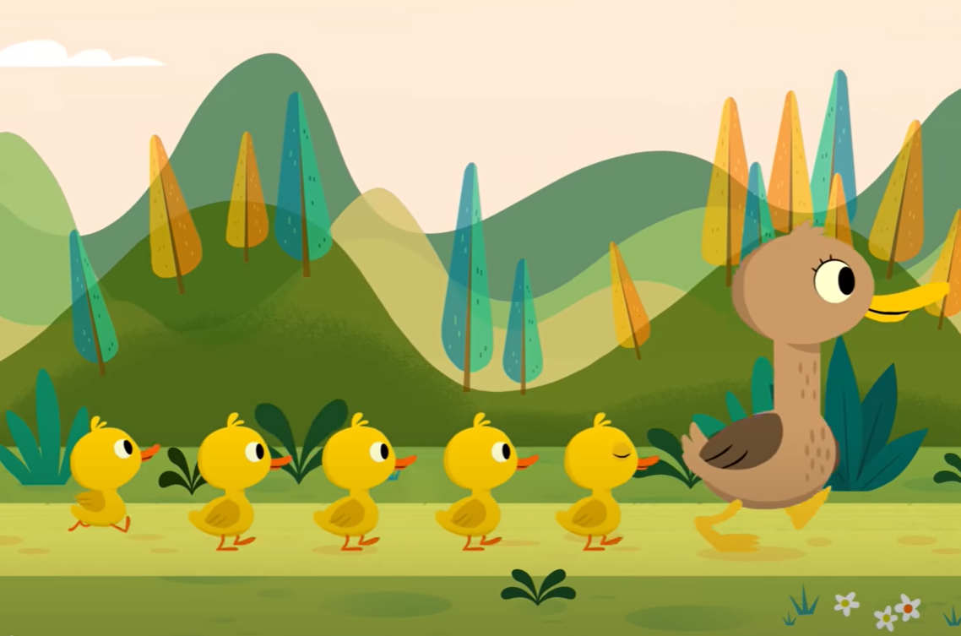
Video
We can say numbers
Let’s watch and sing along to this video

Slide 5
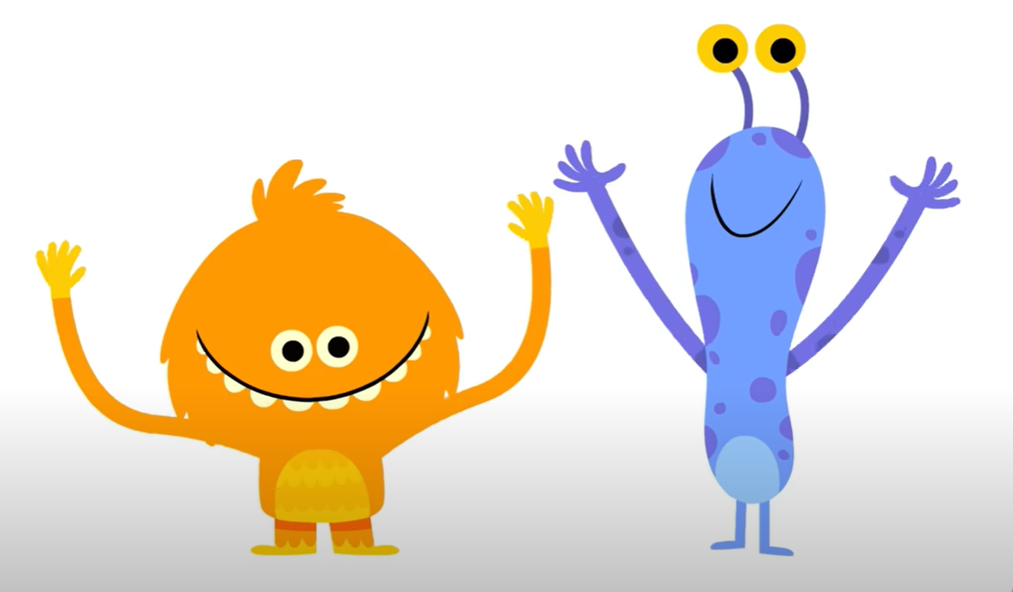
Video
We can count to 10
Let’s watch and sing along to this video
Notes:
Apple

Slide 6
Learn
We can count to 10
0
Notes:
Ball

Slide 7
Learn
We can count to 10
1
Notes:
Cat

Slide 8
Learn
We can count to 10
2
Notes:
Dog

Slide 9
Learn
We can count to 10
3
Notes:
Egg

Slide 10
Learn
We can count to 10
4
Notes:
Fish

Slide 11
Learn
We can count to 10
5
Notes:
Gate

Slide 12
Learn
We can count to 10
6
Notes:
Hat

Slide 13
Learn
We can count to 10
7
Notes:
Itch

Slide 14
Learn
We can count to 10
8
Notes:
Jar

Slide 15
Learn
We can count to 10
9
Notes:
Key

Slide 16
Learn
We can count to 10
10

Slide 17
Learn
We can count to 10
+
plus

Slide 18
Learn
We can count to 10
-
minus

Slide 19
Learn
We can count to 10
=
equals

Slide 20
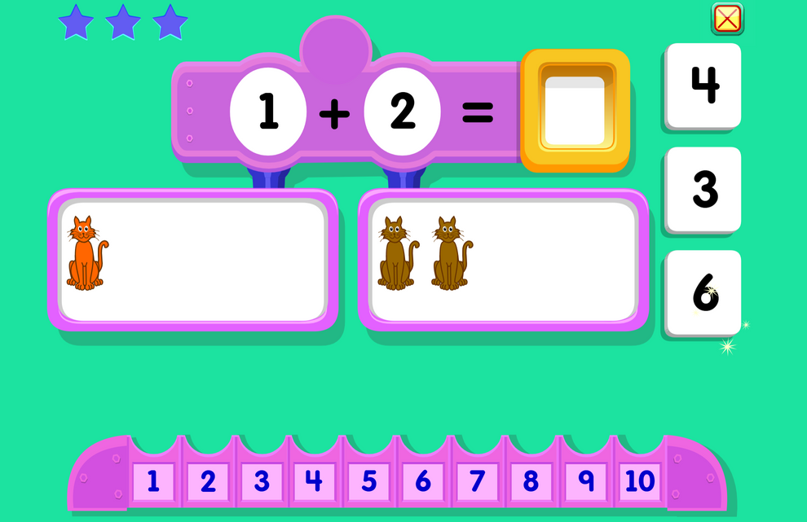
Learn
We can count to 10
Let’s practice!
Let’s do some addition and subtraction and say the numbers

Slide 21

Learn
Song Break!
Notes:
Head, shoulders, knees and toes

Slide 22
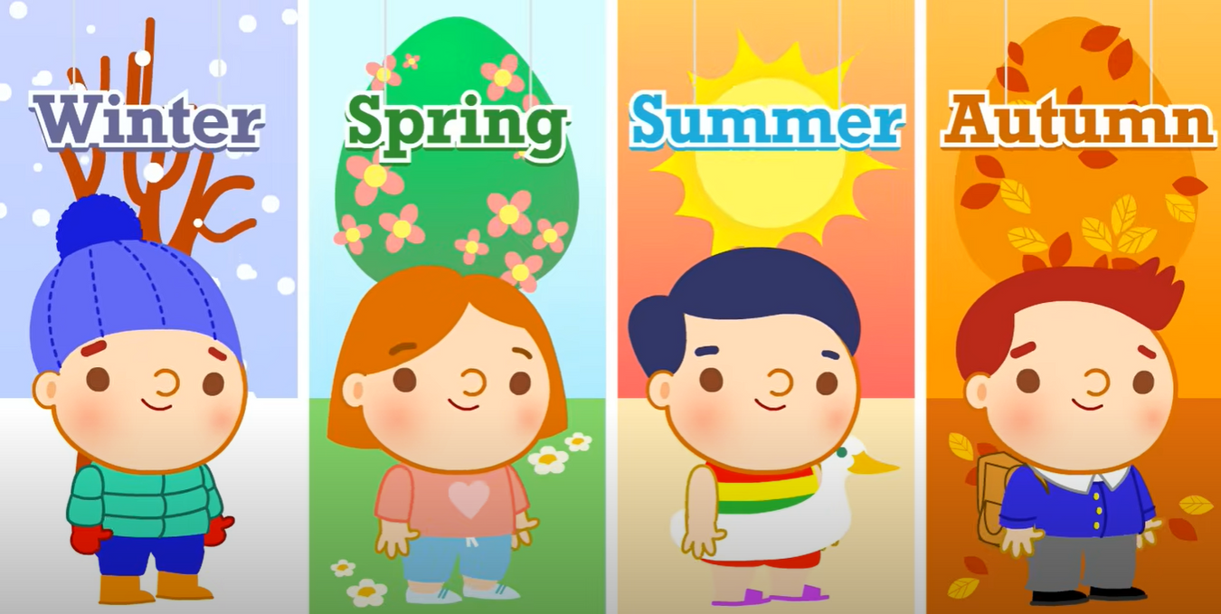
Learn
We can learn the seasons

Slide 23
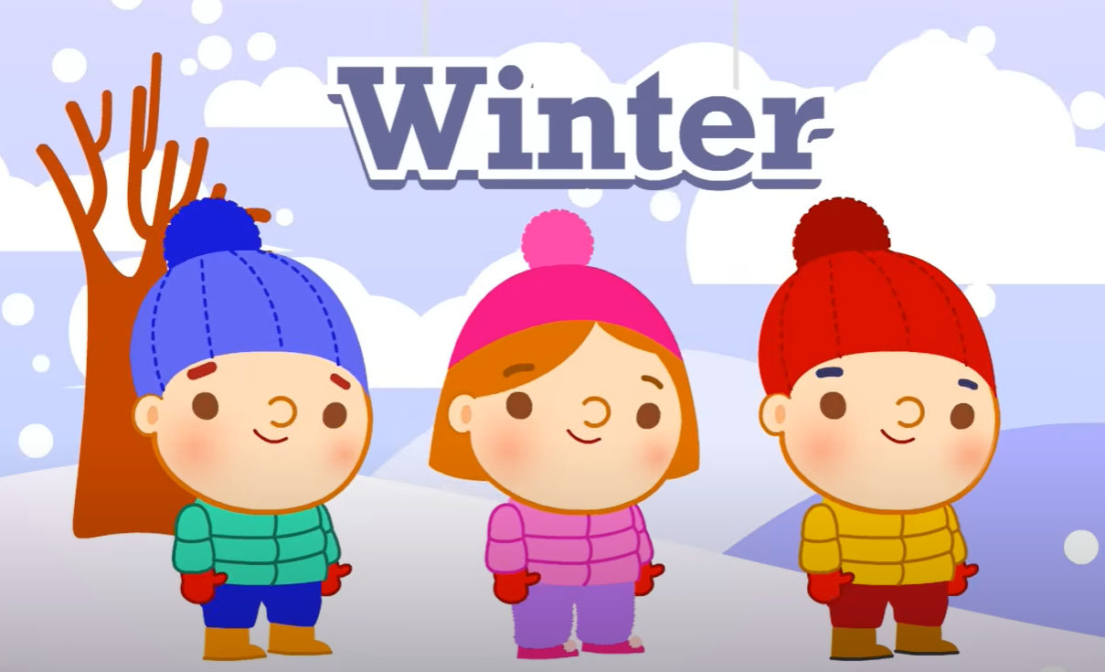
Learn
We can learn the seasons
Notes:
Cold and snow

Slide 24
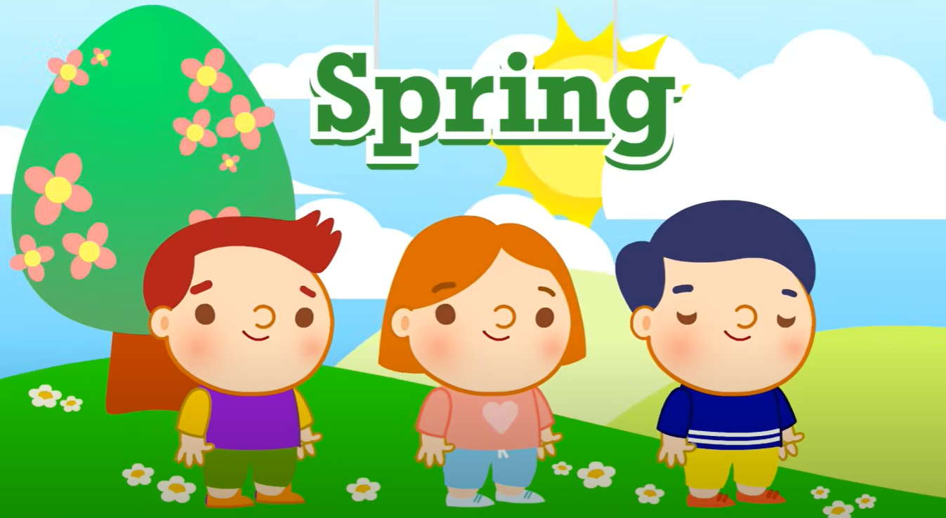
Learn
We can learn the seasons
Notes:
Rain and flowers

Slide 25
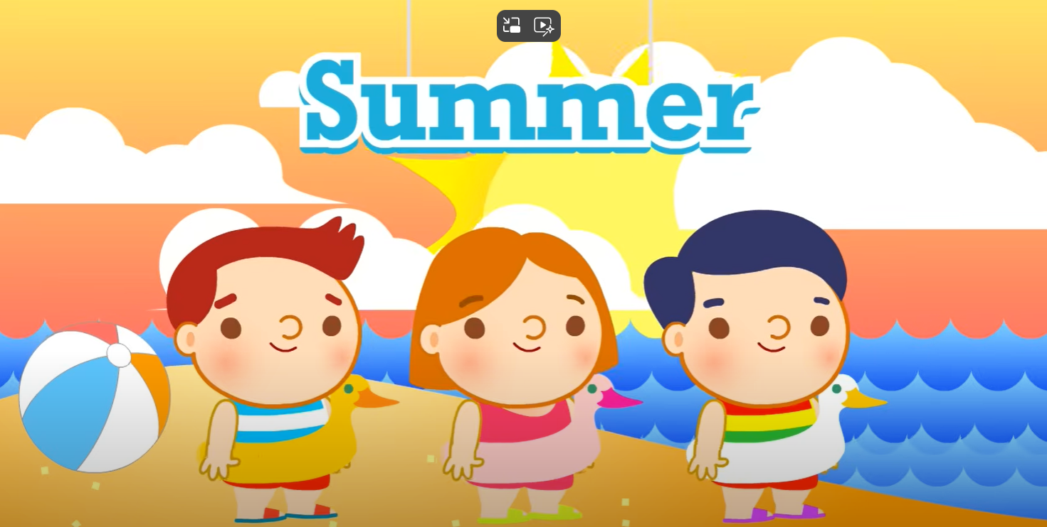
Learn
We can learn the seasons
Notes:
Hot and sun

Slide 26
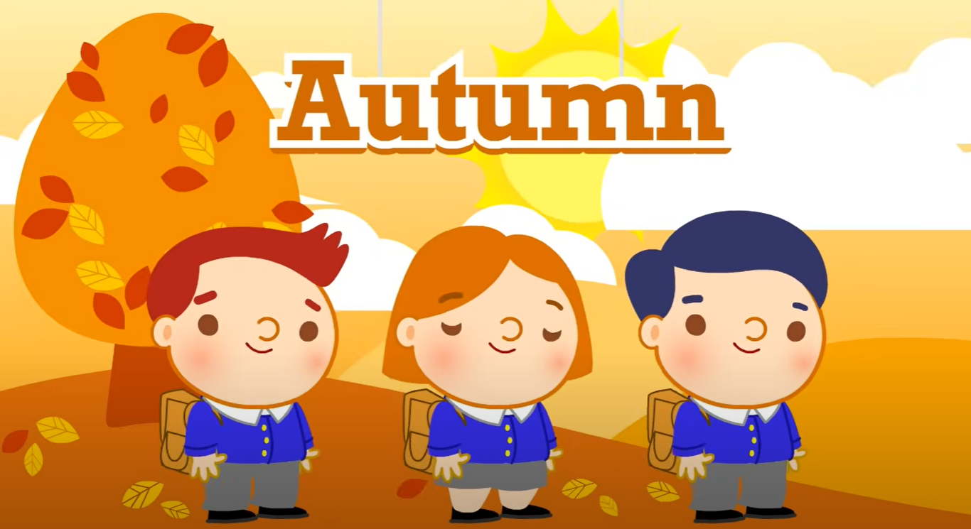
Learn
We can learn the seasons
Notes:
Leaves change color

Slide 27
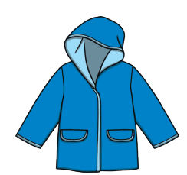

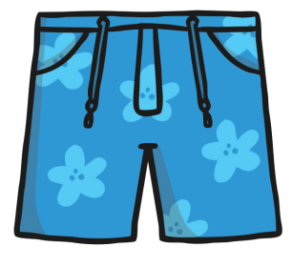
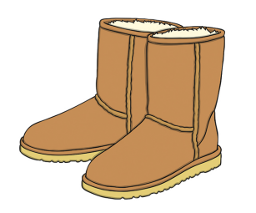
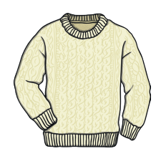
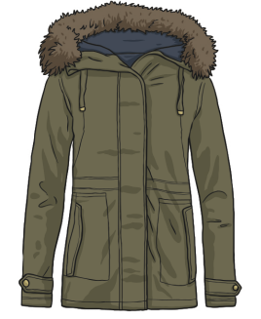

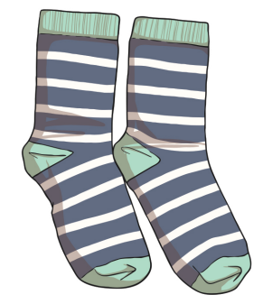
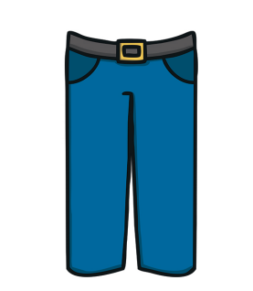
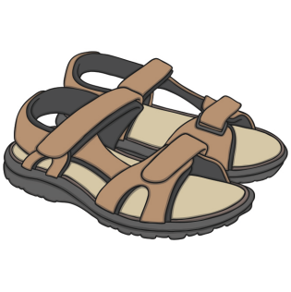
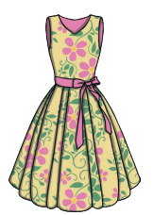
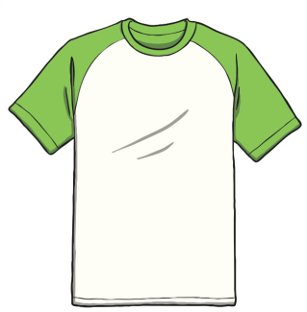
Learn
We can name clothes
Notes:
Zip

Slide 28
Learn
We can name clothes
t-shirt
Notes:
Rabbit

Slide 29
Learn
We can name clothes
trousers
Notes:
Tiger

Slide 30
Learn
We can name clothes
jumper
Notes:
Up

Slide 31
Learn
We can name clothes
socks
Notes:
Volleyball

Slide 32
Learn
We can name clothes
hat
Notes:
Wave

Slide 33
Learn
We can name clothes
shorts
Notes:
Snake

Slide 34
Learn
We can name clothes
wellies
Notes:
Mix

Slide 35
Learn
We can name clothes
dress
Notes:
Yay!

Slide 36
Learn
We can name clothes
raincoat
Notes:
Zip

Slide 37
Learn
We can name clothes
boots
Notes:
Zip

Slide 38
Learn
We can name clothes
coat
Notes:
Zip

Slide 39
Learn
We can name clothes
sandals
Notes:
Zip

Slide 40
Learn
Memorize these - look for 16 seconds
raincoat
shorts
boots
hat
socks
wellies
jumper
jacket
trousers
dress
t-shirt
sandals
Notes:
Zip

Slide 41
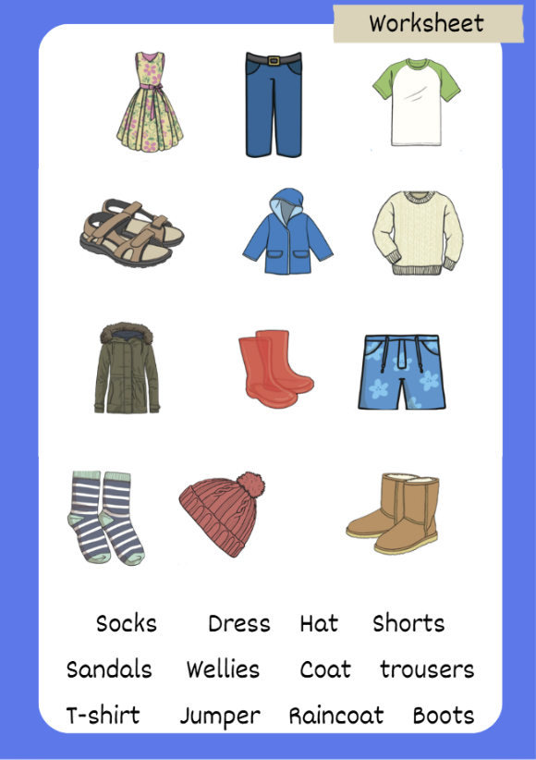
Activity
Match and write the names of the clothing items under each item
Notes:
Zip

Slide 42
Answers
Memorize these - look for 16 seconds
raincoat
shorts
boots
hat
socks
wellies
jumper
jacket
trousers
dress
t-shirt
sandals
Notes:
Zip

Slide 43
Extension
Seasons and clothes matching
Task:
In pairs, cut the clothing items out
Sort them into winter, spring, summer, autumn
Teacher: Instead you can have the seasons stuck on the board, and students can stick the clothing items where they belong.
Notes:
Zip

Slide 44
Learn
Goodbye!
See you next time!
Notes:
Zip

